Slide 1
Basic Concepts of Computers

Slide 2
Agenda
1
Basic Understanding of IT Industry
2
Basic Desktop
3
Office Tools - 2010

Slide 3

Course Objectives (1 of 3)
At the completion of the course,
you will be able to:
Describe the basics of the computer
Identify the various parts of the computer
Describe the basics of the Operating System

Slide 4
Course Objectives (2 of 3)
Explain the basics of Windows 7 Installation
Explain the basics of the
Windows 7 Components
Describe the basics of the Softwares
Describe Windows Update (Patch Management)

Slide 5
Course Objectives (3 of 3)
Describe the Virus and Antivirus Management
Describe the De-fragmentation
Explain the functioning of the Printers
Explain the basics of MS-Office

Slide 6
Day 1 Session
Welcome to the Day 1 Session on Basic Understanding of IT Industry

Slide 7

IT Industry Overview (1 of 4)
The Information Technology ( IT ) industry deals with the design and development of various computer software and hardware applications.
Some of the large multinational companies are IBM, Cisco, HP, Dell, Microsoft, Wipro, TCS and Infosys.
IT has an impact on growth rate of the economy.

Slide 8
IT Industry Overview (2 of 4)
An IT organisation may be a
Product development company
Product company develops particular software application to address the problems faced by business world.
Service based company
Service companies are involved with the development of projects for other companies.

Slide 9

IT Industry Overview (3 of 4)
IT growth includes
Data management
Networking
Hardware development
RDBMS
Software design
BPO and KPO

Slide 10

IT Industry Overview (4 of 4)
IT sector growth includes both IT and ITES (Information Technology Enabled Services).
ITES means the services delivered through telephone and Internet.
IT sector includes small, medium and large companies.

Slide 11

Benefits of IT Industry (1 of 14)
Benefits of IT Industry
Availability of new jobs
The main advantage of IT boom is the creation of new jobs for qualified persons.
In the last two decades IT and ITES industry generated thousands of job opportunities.

Slide 12

Benefits of IT Industry (2 of 14)
The direct employment opportunity resulted in the development of the indirect and other associated industrial sector also.
This helps the economy to flourish.

Slide 13

Benefits of IT Industry (3 of 14)
Growth in Telecom and Communication
Good communication is very important for the development of business and economy.
Information Technology provides the quick communication tools like email, telepresence to the business community.

Slide 14

Benefits of IT Industry (4 of 14)
The development in the telecom sector made the entire world as a global village.
Now a days everyone can afford to their own latest communication devices.

Slide 15

Benefits of IT Industry (5 of 14)
Cost reduction
Computerization of business processes results in cost reduction.
Cost reduction leads to increased productivity and good profitability.

Slide 16

Benefits of IT Industry (6 of 14)
Easy storage and retrieval of information
IT provides cost effective business solutions to store and maintain business knowledge.
Capturing, processing and dissemination of business knowledge are very important for the success of an organisation.
The computer based storage devices replaced the paper based storing of knowledge.

Slide 17

Benefits of IT Industry (7 of 14)
Collaboration and sharing in education
IT offers teachers and students a lot of opportunities to collaborate and share knowledge.
IT provides the possibility of virtual collaboration through emails and e-conferencing.

Slide 18

Benefits of IT Industry (8 of 14)
The education institutions websites provide detailed information to the student's community.
Students can get their examination results, schedules, attendance details on the college website.
Teachers can collaborate with other teachers to work together to build lesson plan and curriculum.
Notes:
.

Slide 19

Benefits of IT Industry (9 of 14)
Creation of new millionaires
The growth in the IT industry created many new millionaires. This increased the purchasing power of the common man.

Slide 20
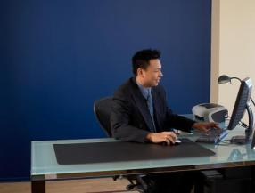
Benefits of IT Industry (10 of 14)
Easy teaching and learning techniques
Technological advancement made teaching easy and interesting for the instructors.
Virtual classroom concept allows a teacher to teach the students sitting in any place in the world.

Slide 21

Benefits of IT Industry (11 of 14)
Computers and projectors help teachers and students in the teaching and learning process.
IT facilitates the learning of special students in many ways.
Any kind of student, intelligent or disabled, can find appropriate learning materials to enhance their knowledge level.

Slide 22

Benefits of IT Industry (12 of 14)
Distance education
The technology advancement in education made distance learning concept very popular.
It has become one of the preferred methods of learning and teaching.

Slide 23

Benefits of IT Industry (13 of 14)
Virtual classrooms replace the actual classrooms and online classes use files transfer, chat rooms and message boards to facilitate student’s interactions.
This gives a flexible education schedule benefit to the students.

Slide 24

Benefits of IT Industry (14 of 14)
Globalization
IT development brings the world closer and together.
It removes the distance and language barrier to share information and ideas with each other.

Slide 25
Demerits of IT Industry (1 of 9)
Demerits of IT industry
Dependency on machines
When IT invades into all areas of a civil society, people start to depend highly on computers and other technologies for everyday existence.
If a machine breaks or a computer crashes, people become handicapped until the problem is resolved.
The dependency on technology puts people at a disadvantage position because they become less self-reliant.

Slide 26

Demerits of IT Industry (2 of 9)
Human values
High competition exists in the job market. Everyone wants to get and retain attractive position.
This attitude leads to decrease in the human values of workers.
Notes:
.

Slide 27

Demerits of IT Industry (3 of 9)
In industries, the machines are used to automate processes and one machine can complete the work of many people. Therefore, companies don't need to employ many people to get the job done.
The more machines and computers become advanced and efficient, this will affect the human values.

Slide 28

Demerits of IT Industry (4 of 9)
Psychological impacts
The increased number of working hours affects the work life balance of employees.
The lack of social contacts can have negative impact on the development of a particular person.

Slide 29

Demerits of IT Industry (5 of 9)
Health and safety
Spending long hours working with computers adversely affect people’s health and safety.
It leads to job stress.
Increase in workload can trigger
job stress and other health problems.

Slide 30

Demerits of IT Industry (6 of 9)
Ergonomic techniques
The work environment should focus on the safety and welfare of the people.
It should be comfortable and convenient.
The lack of proper ergonomics results in negative
impacts on health and safety.

Slide 31

Demerits of IT Industry (7 of 9)
Traffic congestion
The technology development affects both Internet traffic and road transport traffic as more and more number of people started using
the Internet and road.

Slide 32

Demerits of IT Industry (8 of 9)
Privacy
Individual’s privacy is at stake due to the information technology development.
A cookie can track your web surfing.

Slide 33

Demerits of IT Industry (9 of 9)
Cell phone signal can be intercepted and emails can be hacked.
People are worried about private information becoming public knowledge.

Slide 34
IT Infrastructure Overview

Slide 35
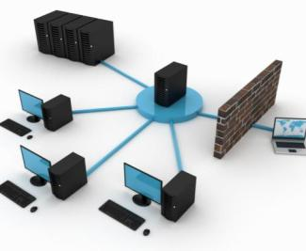
IT Infrastructure (1 of 3)
IT infrastructure refers to the physical hardware used to interconnect computers.
It includes the routers, switches, hubs, telephone lines, cable television lines and satellites.

Slide 36
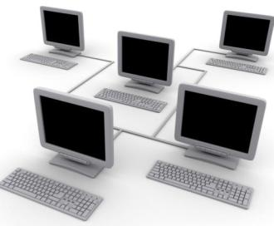
IT Infrastructure (2 of 3)
It also includes the software applications to send, receive and manage the communication signals.
In simple words, it includes everything that supports the flow of information.
IT Infrastructure plays a vital role in promoting the Internet.

Slide 37
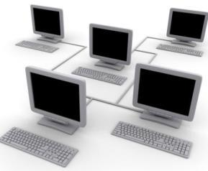
IT Infrastructure (3 of 3)
IT infrastructure incorporates technology to support business needs of an organisation.
This improves the productivity and profitability of a business organisation. It is considered as a core competency for an organisation's success.

Slide 38
Need for IT Infrastructure Tools
Provides a standardised process to maintain.
Need for transparency in IT infrastructure management activities.
Transparency reduces total cost of owning various tools.
Provides scope for service improvement.

Slide 39

IT Infrastructure - Roles
Roles
Provide the IT infrastructure management with minimum investment.
Reduce the operational pressures and improve the effectiveness.
Increase the responsiveness to business demands of the end users.
Reduce the down time of the infrastructure.

Slide 40
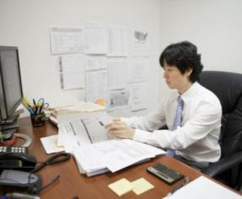
IT Infrastructure - Skills (1 of 3)
Skills required for IT infrastructure provider:
Technical skills
Engineer with networking and communication devices knowledge.
Knowledge of installation and troubleshooting of various operating system and software applications.

Slide 41
IT Infrastructure - Skills (2 of 3)
Knowledge on desktop is required.
Skills to solve desktop / laptop related problems.
Knowledge on electronic circuits and processors.

Slide 42
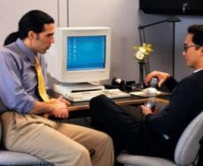
IT Infrastructure - Skills (3 of 3)
Soft skills
Communication skills
The IT person should have good written and oral communication skills.
Interpersonal relationship skills
The IT person needs to interact with various vendors, suppliers and senior staff of the company to deliver the day to day operations.
Interpersonal relationship skills plays a vital role
in achieving the desired results.

Slide 43
Basic Computer Overview

Slide 44
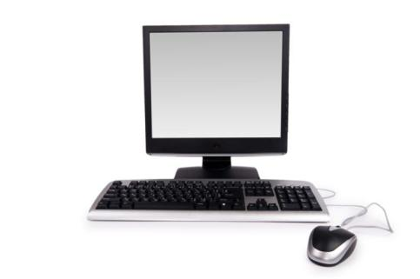
Computer (1 of 2)
A computer is an electronic device that can be programmed to manipulate data.
It accepts instructions and data through input devices.
Processes the data in the CPU.
Provides the output using output devices.

Slide 45
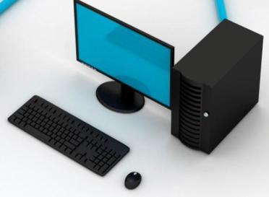
Computer (2 of 2)
A computer consists of a CPU, monitor, keyboard and mouse.
The machinery parts like wires, transistors and circuits are called hardware.
The instructions and data are called software.

Slide 46
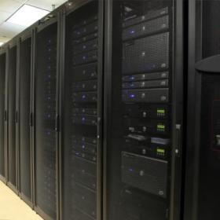
Types of Computer (1 of 5)
Mainframe
It is a huge and powerful computer to handle critical data processing applications of large organisations.
Super Computer
It is a very powerful computer capable of
processing trillions of instructions per second.

Slide 47
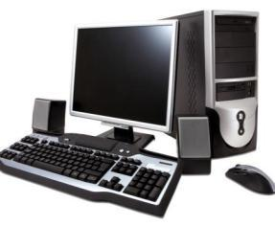
Types of Computer (2 of 5)
Mini Computer
Mini computer was used in early days and it was replaced by desktops.
Desktop
A desktop computer is a Personal Computer (PC)
that is designed for regular use.

Slide 48
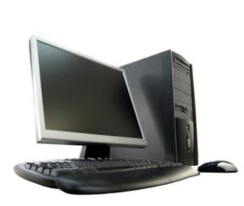
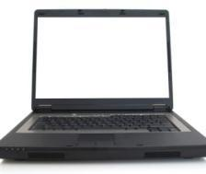
Types of Computer (3 of 5)
Desktop
A computer designed to perfectly fit on the desk consisting of monitor, CPU, keyboard, mouse.
Stores more information and have more features.
They are cheap, easy to upgrade and customise.
Laptop
Laptops are the mobile computers, smaller than the desktop computers.
They run on battery and have components similar to the desktop, which are optimised for mobile use.

Slide 49

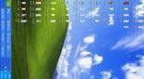
Types of Computer (4 of 5)
Notebook
Light portable mobile computers, thinner than the laptops.
They have minimal graphic subsystem.
They have an integrated modem.
Tablet
Tablet computers are mobile computers with touch screen interface.
They are smaller than the notebook computers.

Slide 50
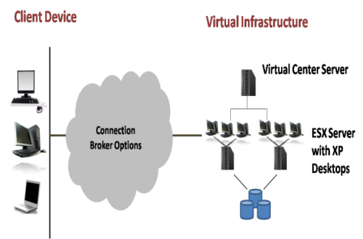
Types of Computer (5 of 5)
Virtual Desktop Infrastructure (VDI)
Virtual Desktop Infrastructure (VDI) enables users to access their desktop from anywhere.
User’s desktop looks like regular Windows desktop and the thin client functions as a desktop.
VDI helps achieving improved productivity
and high data security.

Slide 51

Uses of Computer
Laboratory
Physicians and nurses enter lab tests details in the computer. Patients are provided with barcode. The machines in lab read the barcode and perform the specific test mentioned by doctors.
Industries
Use computer to maintain accounts, to improve quality and productivity.
Hotel
It is used for room reservation and inventory maintenance.

Slide 52
Basic Hardware Overview

Slide 53
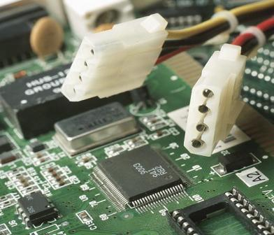
Introduction to the Components of System (1 of 25)
The various parts of the system are:
Motherboard
Central Processing Unit (CPU)
Processor
Microchips and micro-circuitry
SMPS

Slide 54
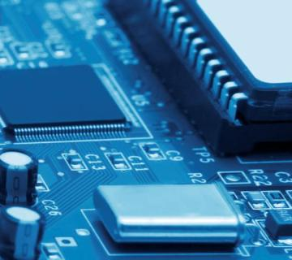
Introduction to the Components of System (2 of 25)
Graphic / Video Card
Sound Card
Network Interface Card (NIC)
CPU Cooling Fan
Bus Architecture
System Ports

Slide 55
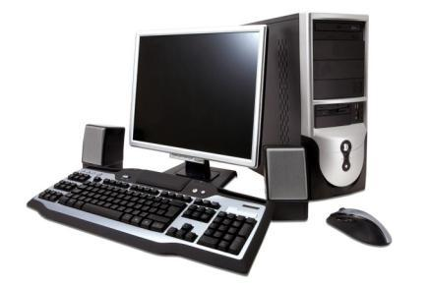
Introduction to the Components of System (3 of 25)
PCI Slots
Memory
Input Devices
Hard Drives
Ports

Slide 56
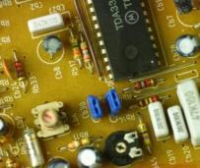
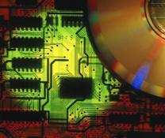
Introduction to the Components of System (4 of 25)
Motherboard
The core components of the PC reside in the motherboard.
The support cards for video, sound, networking are mounted on the mother board.
Different types of Motherboard
There are three types of motherboard
XT (Extended Technology)
AT (Advanced Technology)
ATX (Advanced Technology Extended)

Slide 57
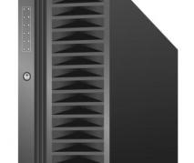
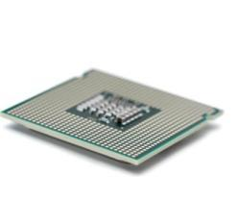
Introduction to the Components of System (5 of 25)
Central Processing Unit (CPU)
Central Processing Unit (CPU) is the main part of a computer that executes all the instructions.
It processes data as per the set of instructions it receives.
Processors
It acts as the “brain” of the PC.
It carries the instructions received from software, using the data entered to produce the output.

Slide 58
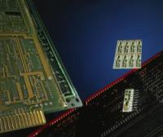
Introduction to the Components of System (6 of 25)
Microchips and micro-circuitry
Microchip usually referred as Integrated Circuit (IC) is an assembly of packed computer circuitry.
Micro- circuitry is a microelectronic computer circuit which is combined into a semiconductor or a chip.
Switched Mode Power Supply (SMPS)
It is an electrical equipment used to convert AC input into DC output .
It is the power source of the computer which regulates the power consumption of different parts.

Slide 59
Introduction to the Components of System (7 of 25)
Switched Mode Power Supply (SMPS)
Switch Mode Power Supply is used to provide a regulated output voltage different from the input voltage.
It incorporates a switching regulator to convert the electrical power.

Slide 60
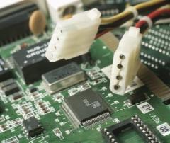
Introduction to the Components of System (8 of 25)
Graphic / Video Card
It is an expansion card, installed on the mother board.
Generates the images to be displayed.
Allows the computer to send graphical information to monitor or projector.
The graphic or video card performs this task using four
peripherals:
Motherboard
Provides the connection for power and data information.

Slide 61

Introduction to the Components of System (9 of 25)
Graphic/Video Card
Processor
To analyse and decide the actions to be performed with each pixel on the display unit.
Memory
To store the temporary information about each pixel and completed images.
Monitor
To display the image.

Slide 62

Introduction to the Components of System (10 of 25)
Sound Card
It is an expansion card, installed on the motherboard.
Also known as Audio Card.
It aids the input and output of audio signal .
It translates the digital information of the computer into analog information.
Provides the input and output of audio signals.

Slide 63
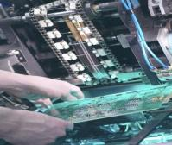
Introduction to the Components of System (11 of 25)
Network Interface Card (NIC)
It is also referred as Ethernet Card or Network Adapter.
It is an expansion card that authorises the connectivity to a network.
Connects a computer to a network. It is a network adapter and works with wired and wireless connections.
Connects to the network using an Ethernet cable with an RJ 45 connector. Most of the latest computers have in-built NIC card on the motherboard.

Slide 64
Introduction to the Components of System (12 of 25)
CPU Cooling Fan
A CPU cooling fan acts as a cooling device which draws the cool air inside and expels the hot air outside.
Helps in cooling the processor.
Using the computer for a longer duration causes an increase in the processor’s work load.
The increased work load results in processor generating more heat.
This overheating can damage the processor. The CPU cooling fan helps cooling the processor. Heat Sink and fan cools the CPU as it gets heated when PC is on.
The Pentium processor runs at 70ºC with a heat sink and fan.

Slide 65
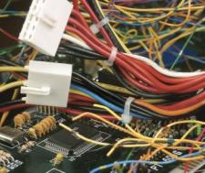
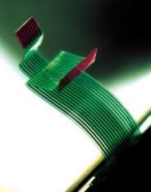
Introduction to the Components of System (13 of 25)
Bus Architecture
The bus architecture of a PC usually refers to the I/O or expansion bus on the motherboard into which devices such as modem and sounds cards are connected.
Types of Bus
ISA
MCA
EISA
VESA
PCI
AGP
AMR
CNR
PCMCIA

Slide 66
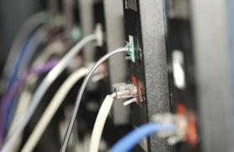
Introduction to the Components of System (14 of 25)
System Ports
Port refers to a connection point.
These are used to connect to input or output devices to the system.
Peripheral Component Interconnect (PCI) Slot
Mounted on the motherboard, used to connect various hardware devices to the computer.
Help adding extension cards to a computer.

Slide 67
Introduction to the Components of System (15 of 25)
Random Access Memory (RAM)
Random Access Memory allows to store data accessed by CPU.
Storage of larger files such as complex graphics, sound or animation requires RAM.
It is a volatile memory.
Read Only Memory (ROM)
ROM refers to the memory chip containing semi permanent or permanent data or information.
Data stored in ROM cannot be modified.
It is a non-volatile memory.

Slide 68
Introduction to the Components of System (16 of 25)
Difference between RAM and ROM
RAM | ROM
RAM stands for Random Access Memory | ROM stands Read Only Memory
It is used to write and read | It is used only to read
It is a volatile memory | It is a non-volatile memory
It is used by programs to temporarily hold the data | It is used to store the programs and data permanently

Slide 69
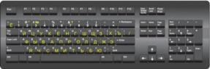
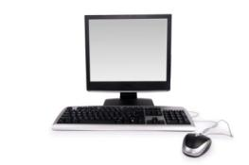
Introduction to the Components of System (17 of 25)
Keyboard
Keyboard is a device which enables the user to enter text commands into the computer.
It includes alphanumeric keys, punctuation keys and special keys.
Monitor
A monitor is a display device, which acts as an interface between the user and the other parts of the computer.
It is also called Visual Display Unit.

Slide 70
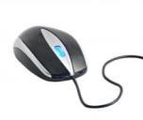
Introduction to the Components of System (18 of 25)
Joystick
It is an input device which can be moved in all directions.
It controls the actions of the pointer.
It contains a lever to control the movement of the pointer.
Mouse
Mouse is a pointing device attached to a computer.
It helps to draw and move the cursor on the screen.
Mouse contains small sensors on the roller ball.
Notes:
Joystick

Slide 71
Introduction to the Components of System (19 of 25)
Mouse
Mouse contains small sensors on the roller ball.
When the mouse moves, the sensors keep track of the direction of the roller ball and moves the cursor on the screen accordingly.

Slide 72
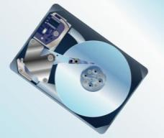
Introduction to the Components of System (20 of 25)
Understanding Hard Drive
It is an internal drive having good storage capability.
It is used for storing computer data and information.
Also helps in retrieving the data and information.
Offers faster response time.
Storage devices use IDE type of connection to connect hard drives and optical drives to each other and to the motherboard.

Slide 73

Introduction to the Components of System (21 of 25)
Understanding Hard Drive
IDE implementations are of two types: Parallel ATA (PATA) and Serial ATA (SATA).
Serial ATA (SATA) IDE standard connects hard drives and optical drives to the motherboard. SATA cables are long, thin, 7-pin cables. Its one end is attached to the motherboard port and the other is linked to the storage device.

Slide 74

Introduction to the Components of System (22 of 25)
Installing Hard drive
Prerequisites:
Switch off the power to the computer.
Keep the drive in a safe place.
Protect the drive from static discharge.
Handle the circuit board carefully.
Keep the screw driver and other materials ready.

Slide 75
Introduction to the Components of System (23 of 25)
Installing Hard drive
Open the packing and take the drive out.
Slide the drive into a slot and find the case screws. (You can use the case screws to stick the drive to case.)
Once the drive is secured, connect the power and IDE cables.
Connect the IDE cable to the motherboard.
Start the computer and enter into the BIOS to ensure that the drive is identified properly.

Slide 76
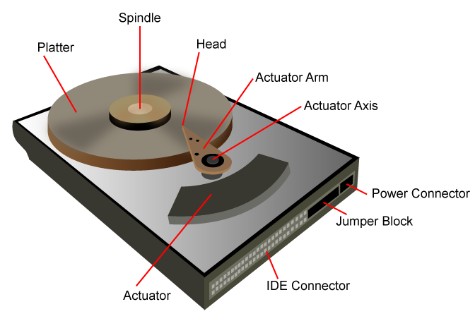
Introduction to the Components of System (24 of 25)
Components of Hard Drive are:
Platter
Spindle
Actuator
Actuator Arm
Actuator Axis
Head
Power
Jumper Box

Slide 77
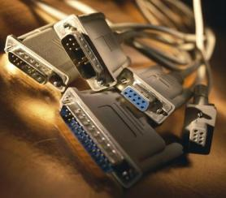
Introduction to the Components of System (25 of 25)
System Ports
SERIAL
PARALLEL
USB
IEEE 1394 (firewire)
INFRARED

Slide 78
Ports (1 of 3)
SERIAL
Serial port is a communication interface for transfer of data; in or out one bit at a time. This type of port communicates serially (bit 2 bit) between processor and device.
PARALLEL
Parallel port is a communication interface for data transfer. It transmits and receives data bits at the same time. This type of port communicates parallel (byte 2 byte) between processor and device.

Slide 79
Ports (2 of 3)
Universal Serial Bus (USB)
This is a type of serial port high speed throughput. Comes with speed 480 Mbps. PS/2 port connects keyboard and mouse. Video card port connects the monitor.
IEEE 1394
This is a type of serial port high speed throughput. Comes with speed 800 Mbps.

Slide 80
Ports (3 of 3)
INFRARED
This is a type of wireless communication port high speed throughput. Comes with speed 4.5 Mbps.

Slide 81
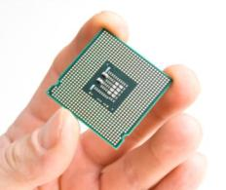
Complementary Metal Oxide Semi-Conductor (1 of 2)
Complementary Metal Oxide Semi-Conductor (CMOS).
Stores roughly 64Kb of data.
Specs stored in CMOS must match hardware.
Allows to access the BIOS.
When hardware is changed / updated, CMOS must be updated.

Slide 82

Complementary Metal Oxide Semi-Conductor (2 of 2)
Updates to hardware, for instance adding RAM or changing a hard disk are stored in CMOS.
CMOS is stored in SRAM chip called Non-Volatile Random Access Memory (NVRAM).
The mouse doesn’t work in CMOS setup.

Slide 83

Basic Input Output System (1 of 2)
Basic Input Output System (BIOS).
It is a chip on the motherboard which is stored in the PC’s ROM chip.
Supports all hardware on 286 AT PC.
Stores a set of instructions to control devices.

Slide 84
Basic Input Output System (2 of 2)
Provides low-level hardware access.
Tests hardware on startup using POST.
Runs bootstrap loader after POST.
The BIOS sits between the hardware and the operating system.
APPS
OS
AT computer
BIOS
Hardware

Slide 85
Boot Process (1 of 2)
When the computer is started, the CPU goes into the BIOS ROM.
Once the CPU starts the BIOS start up program, the BIOS conducts POST (Power On Self Test) to check if there is any fatal errors.
BIOS detects and configures any device it finds while booting.
BIOS displays a summary of system's configuration and looks for a drive to boot.

Slide 86
Boot Process (2 of 2)
If BIOS finds a drive to boot, then it initiates the booting process from the information collected from the drive.
After this, the windows loading screen appears.
Then the login screen appears.

Slide 87
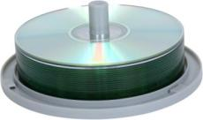
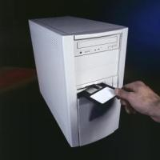
About Drives (1 of 5)
Compact Disc (CD) / Digital Versatile Disc (DVD)
CD-ROM and DVD are the options for long term storage and retrieval of data.
Floppy Drive
It is an external drive.
It is a soft magnetic portable disk which comes in three basic sizes 8 inch, 5.25 inch and 3.5 inch.

Slide 88
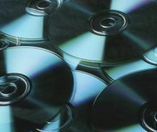
About Drives (2 of 5)
Optical drive
Optical drives are portable and used to store data.
Tape drive
A tape drive stores data on magnetic tape for backup and archiving purposes.
It has a large capacity to store data and it is economical.

Slide 89
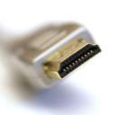
About Drives (3 of 5)
Flash drive
Flash drive is a small storage device used to transfer data from one computer to another.
Small computer system interface (SCSI)
Small Computer System Interface (SCSI) is a parallel interface standard to attach peripheral devices to computers.
It provides fast data transmission than serial and parallel ports.

Slide 90
About Drives (4 of 5)
Small Computer System Interface (SCSI)
SCSI is a peripheral, intelligent, buffered, peer to peer interface.
It hides the complexity of physical format.
The Small Computer System Interface protocol defines communication from host to a peripheral device, host to host, peripheral device to a peripheral device.

Slide 91
About Drives (5 of 5)
Small Computer System Interface (SCSI)
Small Computer System Interface (SCSI) is a set of standards for transferring data between peripheral devices and computers.
The Small Computer System Interface standards define protocols, commands, optical and electrical interfaces.
It is commonly used for tape drives and hard disks.
It can also connect a wide range of other devices, including CD drives and scanners.

Slide 92
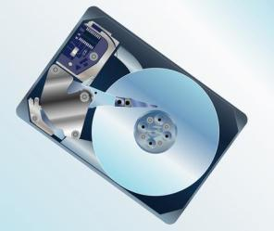
Working of a Hard Drive (1 of 2)
The working of a hard drive:
Hard drive uses stiff revolving disks (platters).
On each planar magnetic surface of platter digital data is stored.
By transmitting an electromagnetic flux through read-write head or an antenna, the information is written on the disk which is very close to a magnetic material.

Slide 93
Working of a Hard Drive (2 of 2)
Due to the flux, the polarisation gets changed.
The information then, can be read by read-write head.

Slide 94
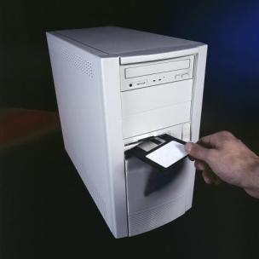
Working of a Floppy Drive
It is a magnetic material which is similar to a recording tape.
Recording is done on either one or two sides of the disk.
The disk drive through its center grabs the floppy and whirl like a record inside its quarters.

Slide 95
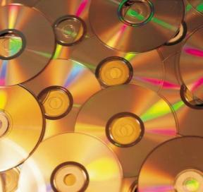
Working of an Optical Drive (CD/DVD) (1 of 3)
An optical drive (CD/DVD) is composed of 3 layers.
The layer on which the label of the CD is given for identification is the non-silvered layer. Reflective layer is the middle layer.
All the data in microscopic pits is stored in the reflective layer.

Slide 96
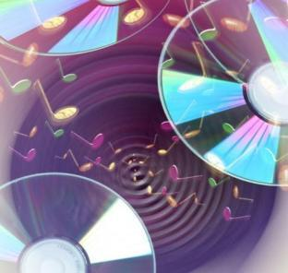
Working of an Optical Drive (CD/DVD) (2 of 3)
When a software is burned to burn the data on a CD or DVD which is inserted in the respective optical drive, the mass produced commercial software don’t get burned on optical discs as it has a quicker method.
It includes the use of a mold to seal press the data in pits on the reflective layer in a disc.

Slide 97
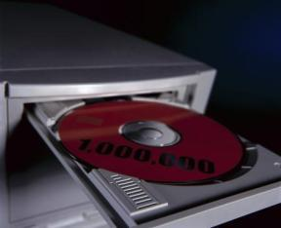
Working of an Optical Drive (CD/DVD) (3 of 3)
When a CD or DVD is inserted in CD-ROM or DVD-ROM drive, on the reflective layer of optical disc a laser focuses a beam of light.
The light focused on pits gets scattered, whereas on land it gets reflected back with high intensity and is stored in photo diode array.
The diode array helps in reading and analysing the data.

Slide 98
Working of a Tape Drive (1 of 2)
Tape drive are the magnetic tapes. These are used for retrieving and storing the data.
When the tape is empty, highest numbers of microscopic magnets are randomly oriented on the tape.
If any particular pattern is lacking then it doesn’t represent any form of data.

Slide 99
Working of a Tape Drive (2 of 2)
When the data is written onto the tape, a magnetic field orients the magnets into binary data, using “north” magnetic field to represent 1’s and “south” to represent 0’s.
When the tape is not exposed to magnets and remains stable, the data is retained.

Slide 100
Working of a Flash Drive (1 of 2)
Flash drive is inserted in the USB port. It is used for storing data.
Once the work is done, the device should be ejected from the computer.
The system will prompt you when the flash drive is safe to remove, after which it can be physically removed.
Flash drive consists of a Printed Circuit Board (PCB).

Slide 101
Working of a Flash Drive (2 of 2)
It is covered in a rubber casing or plastic, which makes it solid or bulky.
A USB connector is covered with a removable cap.
When it is plugged into a computer, a block-structured logical unit is presented to the PC’s OS.
This way OS can use any block addressing system or file system and attains absorption from the complex implementation details of flash memory devices.

Slide 102
Backup (1 of 2)
Backup is making copies of data which is used later to restore the original data after a loss event.
Backup has two processes
Primary purpose
Secondary purpose

Slide 103
Backup (2 of 2)
Primary purpose
It recovers data after the loss, whether it happened by data corruption or data deletion.
Secondary purpose
It recovers the data from an earlier time, according to a user-defined data retention policy, which is configured typically within a backup application for how long data copies are required.

Slide 104
Restore
When the data is lost due to file corruption or deletion, using backup the data gets restored in the database.
Restoring of the data is necessary as file corruption and deletion is very frequent.

Slide 105
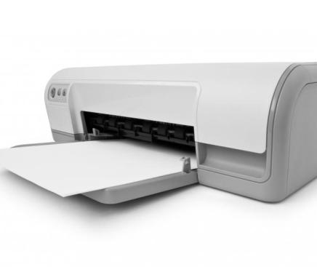
Printer
Printer is an output device used to print the stored information on paper.

Slide 106

Different Types of Printer
There are 2 different kinds of printers:
Impact
Non - Impact

Slide 107
Types of Printers (1 of 2)
Impact Printers
This category of printing devices creates an image by using mechanism to physically press an inked ribbon against the page, causing the ink to be deposited on the page.
Examples of Impact Printers are:
Dot Matrix Printer
Daisy Wheel Printer

Slide 108
Types of Printers (2 of 2)
Non-Impact Printers
These Printers don’t operate by striking the Head or the Needle against the Ribbon or the Ink.
Examples of Non-Impact Printers are:
Ink-jet
Laser

Slide 109
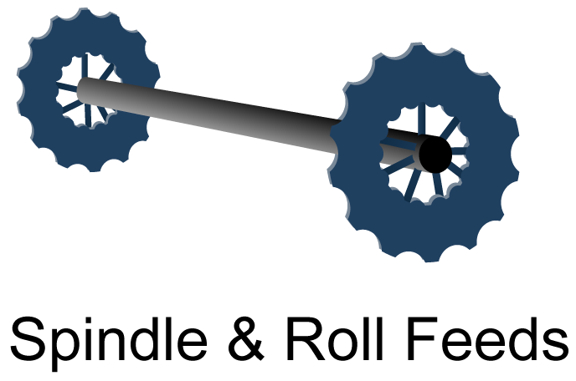
Components of Printer
The components of a printer are:
Batteries, rechargers and adapters
Printer cables
Bluetooth USB Wireless Adapter
Paper handler
Transfer Belts
Spindle and roll feeds
Memory
Fuser
Ink cartridge
Paper Feeding Kit

Slide 110
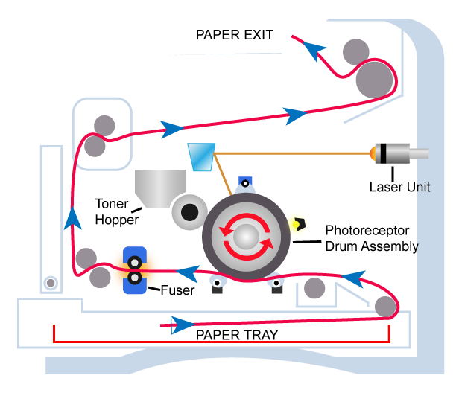
Laser Printer Print Execution

Slide 111
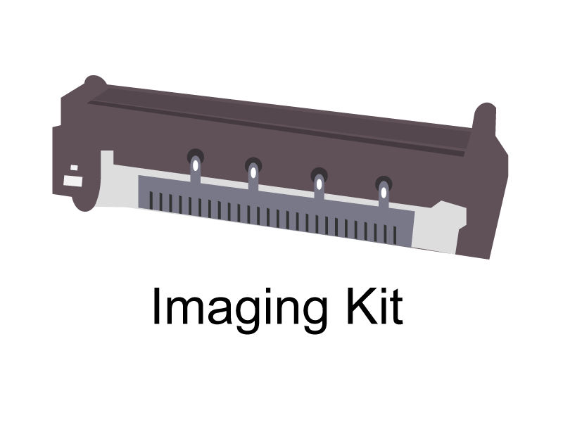
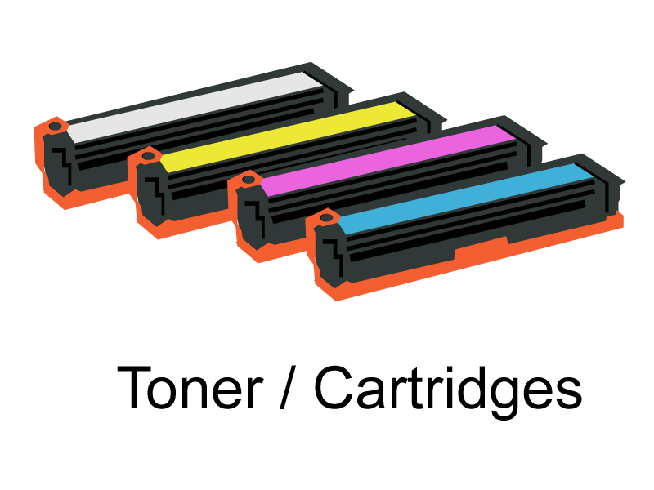
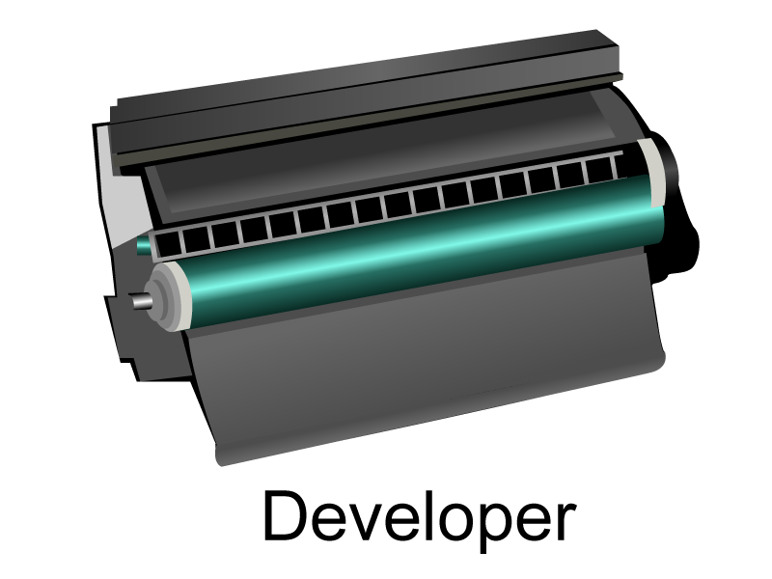
Consumables of Printer
The Consumables of a printer are:
Ink cartridge / Toners
Batteries
Waster Toner Box
Developer
Imaging Kit

Slide 112
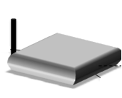
Modem
Modem enables a computer to transmit data over telephone or cable lines. It stands for modulator - demodulator.

Slide 113
Different Types of Modem (1 of 2)
The different types of modem are:
Internal modem
Internal modem is installed inside a computer to communicate over a network with other connected computers.
External modem
External modem is a separate device which uses other interfaces to connect with a computer.

Slide 114
Different Types of Modem (2 of 2)
USB modem
Uses USB port only for connection.
DSL (Digital Subscriber Line) modem
Connects a computer or router to a DSL phone line.

Slide 115

Scanner (1 of 2)
Scanner is a device used to capture images from any other sources for editing and display.
It captures the paper images and stores as a graphic file.
Scanners come in flatbed types, feed-in and hand-held for scanning color only or black-and-white.

Slide 116

Scanner (2 of 2)
High resolution scanners are used for scanning high-resolution printing and lower resolution scanners are used for capturing images for computer display.
The following are some of the types of scanners available in the market:
Drum scanner
Flatbed scanner
CIS scanner
Film scanner

Slide 117
Digital Camera Card
Digital memory card helps to store images and other information from cameras.
A particular camera supports different cards.
It is based on flash memory that is a non-volatile form of memory.
It does not need power to store data.
A card can record thousands of quality images.

Slide 118

Knowledge Check
List five benefits of IT Industry.
Notes:
List five benefits of IT Industry.
Availability of New Jobs
Growth in Telecom and Communication
Easy Storage and Retrieval of Information
Collaboration and sharing in Education
Easy teaching and learning techniques
Globalisation
Distance Education

Slide 119
Knowledge Check
List four demerits of IT Industry.
Notes:
List four demerits of IT Industry.
Dependency on machines.
Human values
Psychological impact
Health and safety

Slide 120
Knowledge Check
List the skills required for providing IT Infrastructure.
Notes:
List the skills required for providing IT Infrastructure.
Technical Skills
Soft skills

Slide 121
Knowledge Check
What is a Computer?
Notes:
What is a Computer?
A computer is an electronic device that can be programmed to manipulate data.

Slide 122
Knowledge Check
List the difference between a Desktop, Laptop, Notebook and Tablet .
Notes:
List the difference between a Desktop, Laptop, Notebook and Tablet.
A computer designed to perfectly fit on the desk consisting of monitor, CPU, keyboard, mouse.
Laptops are the mobile computers, smaller than the desktop computers.
Notebook is a light portable mobile computers , thinner than the laptops.
Tablet computers are mobile computers with touch screen interface.

Slide 123
Knowledge Check
What is a Motherboard?
Notes:
What is a Motherboard?
The core components of the PC reside in the motherboard.
The support cards for video, sound, networking etc. are mounted on the mother board.

Slide 124
Knowledge Check
List the different types of Printers.
Notes:
List the different types of Printers.
Impact
Non-impact

Slide 125
Knowledge Check
List any two differences between RAM and ROM.
Notes:
List any two differences between RAM and ROM.
RAM stands for Random Access Memory
It is used to write and read
It is a volatile memory
It is used by programs to temporarily hold the data
ROM stands Read Only Memory
It is used only to read
It is a non-volatile memory
It is used to store the programs and data permanently

Slide 126
Knowledge Check
What is meant by BIOS?
Notes:
What is meant by BIOS?
Basic Input Output System (BIOS). It is a chip on the motherboard which is stored in the PC’s ROM chip.

Slide 127
End of Day 1 Session
Let’s meet tomorrow for the next session

Slide 128
Day 2 Session
Welcome to the Day 2 Session on Operating System (OS)

Slide 129
FAT32
FAT32 (File Allocation Table)
FAT32 is a simple and well documented old file system supported by many tools and many Operating Systems.
FAT32 is used to have access from DOS mode.
It was designed to use on floppy disks in the late 1970s.
The FAT format major versions are named as per the number of table element bits: FAT12, FAT16 and FAT32.

Slide 130
New Technology File System (NTFS)
NTFS (New Technology File System) is a proprietary file system developed by Microsoft, primarily used in Windows operating systems.
It was introduced with Windows NT in 1993 and has since become the default file system for modern Windows versions due to its performance, reliability, and security features.

Slide 131
NTFS
NTFS (New Technology File System)
NTFS is a feature rich and proprietary new file system.
It is not documented at raw bytes level and subject to change very often.
It is used to access files that are over 4G in size.
Windows NT, Windows 2000, Windows XP and all other later versions use NTFS (New Technology File System).
It provides good support for metadata and uses advanced data structures to improve performance, reliability and disk space utilisation.

Slide 132
Key Features of NTFS
1. Reliability and Data Integrity
Journaling: NTFS maintains a transaction log (journal) of file changes, which helps recover data in case of system crashes or power failures.
Self-Healing (CHKDSK & NTFS Self-Repair): Detects and repairs file system corruption automatically.
Bad Sector Mapping: NTFS can mark bad sectors on the disk and avoid using them.

Slide 133
Key Features of NTFS
2. Security Features
Access Control Lists (ACLs): Fine-grained permissions allow control over who can read, write, and execute files.
Encryption (EFS - Encrypting File System): Built-in encryption provides enhanced data protection.
BitLocker Support: Full-disk encryption to prevent unauthorized access.

Slide 134
Key Features of NTFS
3. Storage Efficiency
Compression (NTFS Compression): Reduces file size to save disk space.
Sparse Files Support: Allocates space only when needed, beneficial for large databases.
Hard Links & Symbolic Links: Allows a file to exist in multiple locations without duplication.

Slide 135
Key Features of NTFS
4. Performance Enhancements
Master File Table (MFT): Central index for all files, improving file access speed.
Disk Quotas: Administrators can set storage limits for users.
Transactional NTFS (TxF): Ensures atomic file operations for better data consistency.
5. Large File and Volume Support
File Size Limit: Supports files up to 16 TB (theoretical maximum up to 16 EB).
Partition Size: Can handle volumes up to 256 TB (with Windows Server).

Slide 136

Common NTFS Commands in Windows

Slide 137
Encrypting File System (EFS) in NTFS
Encrypting File System (EFS) is a built-in encryption feature of the New Technology File System (NTFS) in Windows.
It allows users to encrypt files and folders to protect sensitive data from unauthorized access.

Slide 138
How EFS Works
File Encryption: When a user encrypts a file, Windows generates a unique encryption key.
Public Key Encryption: The encryption key is further encrypted using the user’s public key.
Secure Storage: The encrypted key is stored with the file in NTFS metadata.
Decryption: When an authorized user accesses the file, Windows decrypts the key using their private key and grants access.
Transparent Access: Authorized users can read and modify the file as usual, but unauthorized users cannot.

Slide 139
Key Features of EFS
✅ Strong Encryption
Uses AES (Advanced Encryption Standard) with 256-bit keys (Windows 10 and later).
Older Windows versions use 3DES (Triple DES) encryption.
🔒 User-Based Security
Only the user who encrypted the file (or an assigned recovery agent) can decrypt it.
Files remain encrypted even if moved to another NTFS volume.

Slide 140
Key Features of EFS
🚀 Seamless Operation
Encryption and decryption happen automatically in the background.
Users can open and edit encrypted files without extra steps.
🛠️ Support for Multiple Users
EFS allows additional users to access encrypted files by adding their public keys.
Useful for shared encrypted files among trusted users.
🔄 Key Backup & Recovery
Users can create Data Recovery Agents (DRA) for recovery if encryption keys are lost.
Encrypted files remain unreadable without the correct private key.

Slide 141
How to Use EFS (Encrypt Files & Folders)
1. Encrypt a File or Folder
Right-click on the file/folder.
Select Properties > Click Advanced.
Check Encrypt contents to secure data > Click OK.
Click Apply > Choose to apply encryption to just the file or the entire folder.

Slide 142
How to Use EFS (Encrypt Files & Folders)
2. Decrypt a File or Folder
Right-click the encrypted file/folder.
Select Properties > Click Advanced.
Uncheck Encrypt contents to secure data > Click OK.
Click Apply to confirm.

Slide 143
How to Use EFS (Encrypt Files & Folders)
3. Backup Your EFS Encryption KeyTo prevent data loss in case of key corruption:
Open Run (Win + R), type certmgr.msc, and press Enter.
Navigate to Personal > Certificates.
Locate the EFS certificate, right-click, and choose Export.
Follow the wizard and save the private key in a safe place.

Slide 144
How to Use EFS (Encrypt Files & Folders)
4. Add Another User to an Encrypted File
Right-click the encrypted file > Properties.
Click Advanced > Details.
Click Add, select the user, and OK.

Slide 145
Components of Encrypting File System (EFS)
EFS User Certificate & Keys
File Encryption Key (FEK)
NTFS File System (EFS Integration)
Data Recovery Agent (DRA)
EFS Service (efslsa.exe)
Windows Certificate Store
Windows CryptoAPI (CAPI)

Slide 146
. EFS User Certificate & Keys
EFS relies on public-key cryptography to encrypt and decrypt files.
🔑 User’s Public & Private Key Pair
When a user encrypts a file for the first time, Windows automatically generates:
Public Key: Used to encrypt the file.
Private Key: Used to decrypt the file (must be securely stored).
The private key is stored in the user’s profile and protected by Windows.
📜 EFS Certificate
The EFS certificate contains the public key and is linked to the user.
It is stored in the Windows Certificate Store.
Users can export the certificate for backup or transfer.

Slide 147
File Encryption Key (FEK)
Every file encrypted by EFS has a unique symmetric key called the File Encryption Key (FEK).
Why? Symmetric encryption (AES) is much faster than asymmetric encryption.
How does EFS use it?
FEK is generated when a file is encrypted.
The FEK itself is encrypted using the user’s public key.
The encrypted FEK is stored with the file as metadata.

Slide 148
NTFS File System (EFS Integration)
EFS is built into NTFS, meaning it only works on NTFS-formatted volumes.
The NTFS metadata stores the encrypted FEK with the file.
When a user accesses an encrypted file:
The OS retrieves the encrypted FEK from NTFS.
It decrypts the FEK using the user’s private key.
The decrypted FEK is used to decrypt the file transparently.

Slide 149
Data Recovery Agent (DRA)
A Data Recovery Agent (DRA) is a designated administrator who can recover encrypted files if the original user loses access.
DRA is required in enterprise environments.
The DRA's public key is also stored with encrypted files, so they can decrypt the FEK if needed.
In domain environments, DRAs are centrally managed via Group Policy.

Slide 150
EFS Service (efslsa.exe)
EFSLSA.EXE (EFS Local Security Authority) is the Windows process responsible for:
Managing encryption and decryption requests.
Retrieving user keys from the Windows Credential Store.
Verifying user identity.

Slide 151
Windows Certificate Store
Stores EFS certificates for all users.
Accessible via certmgr.msc (Certificate Manager).
Allows users to backup and export their encryption keys.

Slide 152
Windows CryptoAPI (CAPI)
EFS uses CryptoAPI (Cryptographic API) for encryption.
It ensures strong encryption algorithms such as:
AES-256 (Windows 10 and later).
3DES (older Windows versions).

Slide 153
Sparse Files in NTFS
A Sparse File is a special type of file in NTFS that allows efficient disk space usage by allocating storage only for the parts of the file that contain actual data.
Unused (empty) sections of the file do not take up disk space, but they still appear as part of the file when accessed.

Slide 154
How Sparse Files Work
Normally, a file occupies physical disk space equal to its size.
A sparse file reserves logical space but only stores actual data.
Empty parts of the file are marked as "sparse" and do not consume disk space.
When data is added, NTFS dynamically allocates space as needed.

Slide 155
Key Features of Sparse Files
✅ Saves Disk Space – Unused sections do not take up physical storage. ✅ Efficient for Large Files – Useful for databases, logs, and virtual machine disk images. ✅ Supported by NTFS – Available in Windows XP and later. ✅ Transparent to Applications – Applications see the file as a normal full-sized file. ✅ Reduces Storage Overhead – Ideal for scenarios where large file sizes are required, but only small portions contain actual data.

Slide 156
Use Cases of Sparse Files
Database Systems (SQL Server, Oracle) – Efficiently handle large but sparsely filled database files.
Virtual Machine Disk Images (VHD, VDI, QCOW2) – Stores only used data blocks.
Log Files & Debugging Data – Logs with large gaps between timestamps.
Backup & Archiving – Saves space in incremental backups.

Slide 157
Advantages & Limitations
✅ Advantages
Reduces disk space usage for large but mostly empty files.
Improves performance by avoiding unnecessary disk allocation.
Optimized for large structured storage like database files and virtual disks.
❌ Limitations
Not Supported on FAT32/exFAT – Only works on NTFS.
May cause fragmentation – Because of dynamic allocation, performance may degrade over time.
Not All Applications Recognize Sparse Files – Some apps may still try to read the full allocated size.

Slide 158
Filesystem Hierarchy Standard (FHS)
The Filesystem Hierarchy Standard (FHS) is a Linux and Unix directory structure standard that defines the organization of files and directories in a Linux operating system.
It ensures consistency across distributions, making it easier for users, developers, and applications to interact with the system.

Slide 159
Key Purpose of FHS
Defines a consistent directory structure.
Helps maintain system organization and security.
Standardizes software installation and configuration.
Supports multiple Linux distributions (Ubuntu, Fedora, Debian, etc.).

Slide 160

FHS Directory Structure

Slide 161

FHS vs. Windows File System

Slide 162
Extended File System (EXT)
The Extended File System (EXT) is a series of Linux file systems developed to provide efficient and reliable data storage.
It was introduced in 1992 and has evolved through multiple versions: EXT, EXT2, EXT3, and EXT4.
These versions have improved features such as journaling, larger file size support, and better performance.

Slide 163

Evolution of EXT File Systems

Slide 164
EXT File System Versions in Detail
1️⃣ EXT (Extended File System)
First Linux file system (1992).
Developed to replace the older Minix File System.
Limitations: Lacked journaling, suffered from fragmentation, and was quickly replaced.

Slide 165
EXT2 (Second Extended File System)
Introduced in 1993, used in early Linux distributions.
Key Features:
Supports large files (up to 2 TiB).
Uses block groups for better storage management.
Allows access control lists (ACLs).
Limitations:
No journaling – after crashes, files must be checked with fsck, which is slow.
✅ Still used for: Boot partitions (/boot) and USB flash drives due to its simplicity.

Slide 166
EXT3 (Third Extended File System)
Introduced in 2001 with journaling support.
Key Features:
Journaling: Prevents corruption during crashes.
Backward compatibility: Can mount EXT2 as EXT3.
Three journaling modes:
Writeback – Fastest but least safe.
Ordered (Default) – Balances speed and safety.
Journal – Safest but slowest.
Limitations:
Limited scalability (max file size: 16 TiB).
Slower performance compared to EXT4.
✅ Still used for: Some older systems requiring stability.

Slide 167
EXT4 (Fourth Extended File System)
Introduced in 2008, it is the default file system for modern Linux distributions.
Key Features:
Supports very large files (up to 16 TiB).
Journaling with checksums to prevent corruption.
Delayed allocation – Improves performance by optimizing disk writes.
Extents – Reduces fragmentation and speeds up access.
Backward compatibility with EXT2 and EXT3.
Limitations:
Fragmentation can still occur over time.
Not the best for very large-scale databases (XFS or Btrfs may be better).
✅ Used in: Modern Linux distributions (Ubuntu, Debian, CentOS, Fedora).

Slide 168

EXT File System Performance & Limitations

Slide 169
Difference between FAT32 and NTFS
FAT32 (File Allocation Table) | NTFS (New Technology File System)
Partition size can be up to 2TB. | Partition size can be up to 2TB and more.
File size can be up to 4 GB. | File size can be up to 16 TB.
No File or Folder security is possible as encryption is not possible. | File or Folder security is possible as encryption can be done.
Supports file name character up to 8.3. | Supports file name character up to 255.
It does not support Unicode file names. | NTFS supports Unicode file name.
It does not allow disk compression. | It allows disk compression.
It handles less memory. | It handles more memory than FAT32 systems.
It does not provide good cataloguing system. | It provides better cataloguing system to stored files for speedy retrieval.
Disk Quota Option is not available. | Disk Quota Option is available.
Cannot convert the disk into dynamic disk. | Conversion of basic disk into dynamic disk is only available in NTFS.

Slide 170

NTFS vs File Systems

Slide 171
Bit and Byte
Bit
The smallest unit of information stored in a computer.
A single bit can hold only either 0 or 1.
A bit can be defined as a variable that can have only two possible values, these two values are often interpreted through binary digits and are usually represented by numerical digits 0 and 1.
Byte
Represents a character (letter, number or symbol).
Unit of data which is eight binary digits long.
The byte is a part of digital information in IT / Computers and telecommunications that most commonly consists of eight bits.

Slide 172
Kilobyte, Megabyte, Gigabyte and Tera byte
1024 Bytes = 1 Kilobyte
1024 Kilobytes = 1 Megabyte
1024 Megabytes = 1 Gigabyte
1024 Gigabytes = 1 Terabyte

Slide 173
Operating System (1 of 5)
Operating System is a set of master control programs that manages all other applications in a computer.
It is an interface between the computer and the user.
It connects both hardware and software and allows the user to interact with the computer.
Prof EW Dijsktra is considered as the father of Operating System.

Slide 174
Operating System (2 of 5)
Computer is merely a collection of hardware and software components if it does not have an operating system.
Operating system coordinates all the components and makes them work.
It handles the internal memory and decides the order of the program execution.
Each OS is specific to a set of processors because the OS needs to understand processor commands.

Slide 175
Operating System (3 of 5)
The OS works with the BIOS to control the basic hardware functions.
When the BIOS can’t perform a task, the OS runs a device driver.
Types of Operating Systems:
Stand alone OS
Network OS
Embedded OS

Slide 176
Operating System (4 of 5)
During 1945 - 1955, the first generation computers did not use any OS.
During 1955 - 1965, the second generation computers used batch OS.
During 1965 -1980, the third generation computers used time sharing OS on IBM 360 machines.
During 1980 -1990, the fourth generation computers used MS DOS and UNIX OS.

Slide 177
Operating System (5 of 5)
From 1990 onwards, the fifth generation knowledge based computers use distributed and network OS.
Windows is the most widely used OS for personal computers. It uses a graphical user interface to help the users. Bill Gates is the CEO of Microsoft windows.

Slide 178
Major Players in Operating System
The major players of Operating System:
Microsoft Corporation
Novel / The Open Group
Apple Inc.
Microsoft | Novel | Apple
MS - DOS | Unix | MACINTOSH
Windows 95 | Linux
Windows 2000
Windows XP
Windows 7
Windows 2000 Server Edition
Windows 2003 Server Edition
Windows 2008 Server Edition

Slide 179

Windows Architecture

Slide 180
Different Flavours of Operating System (1 of 4)
The different flavours of operating systems are:
Real-time Operating System
A real time operating system simultaneously processes the various inputs it receives thereby ensuring fast processing.
These are used in systems which require lot of processing such as industrial systems and machinery.
Examples of real time Operating System: PICOS18, LynxOS, OSE, QNX, RTLinux, VxWorks and Windows CE.

Slide 181
Different Flavours of Operating System (2 of 4)
Multi-User Operating System
This allows multiple users to use the system concurrently at same time or at different times.
Example of multi-user operating system: UNIX server.
Single User Operating System
An operating system which can be accessed by only one user at a given time. Examples of single-user operating system: MS-DOS, AmigaOS, Classic Mac OS, Windows 1.0, Windows 2.0, Windows 3.0, Windows 3.1x and so on.

Slide 182
Different Flavours of Operating System (3 of 4)
Multi-Tasking Operating System
Many applications are loaded and concurrently used in the memory.
The processor not only handles one application at a time but also is capable of switching between the applications.
Examples of multitasking operating system: Microsoft Windows 2000, IBM’s OS/390 and Linux.

Slide 183
Different Flavours of Operating System (4 of 4)
Distributed Operating System
This type of operating system is used by companies and firms to power special systems wherein the data and software may be located in different geographical locations and may be accessed from different computer terminals.
Examples of distributed operating system: Windows 2003 + application server (IIS&PWS), Ubuntu and Linux(apache server).

Slide 184
Different Flavours of Windows 7 OS (1 of 4)
The different flavours of Windows 7 OS are:
Windows 7 Starter
Contains very few features.
Runs only three application concurrently.
Available only in 32 bit version.
Lacks features such as media center and touch screen support.
Best suited for netbook computers.

Slide 185
Different Flavours of Windows 7 OS (2 of 4)
Windows 7 Home Basic
Runs basic productivity applications and internet.
Designed for emerging markets only.
Windows 7 Home Premium
Contains features such as touch screen support, media center, full aero glass graphics, improved media format support and streaming.
The feature to easily share files in a home network and new library feature.

Slide 186
Different Flavours of Windows 7 OS (3 of 4)
Windows 7 Professional
Contains all the features of Windows premium.
Additional features include advanced network backup and encrypting file system.
Designed for home workers and small businesses.

Slide 187
Different Flavours of Windows 7 OS (4 of 4)
Windows 7 Enterprise
Includes all the features of Windows 7 Professional.
Additional features includes BitLocker full-disk encryption and direct access capability.
Windows 7 Ultimate
Contains all the features of Windows 7.
It has BitLocker, notably and a few other advanced features.

Slide 188
About Windows 7 (1 of 2)
Windows 7 is the latest release of Microsoft Windows, for use on desktops, laptops, netbooks, tablet PCs and media center PCs. Windows 7's server counterpart for Windows Server 2008 R2 and these 2 were released at the same time.
Advanced Features of Windows 7:
Windows Search: In Windows 7 the Search option is much updated compared to the earlier features.

Slide 189

Windows 10

Slide 190
Windows 10 Flavours
For the consumer
Windows 10 Home: This will be the “consumer-focused desktop edition,” as Microsoft describes it. It will replace the Windows 8 version that most consumers are running on their PCs and tablets. No more choice between Home Basic and Home Premium.
The Home edition will include the company’s new web browser Microsoft Edge (currently codenamed Spartan in the Windows 10 beta), Windows Hello facial recognition and fingerprint scanning login technology and it will have Microsoft’s voice assistant Cortana built in.

Slide 191
Windows 10 Flavours
Windows 10 Mobile: This version will run on smartphones and smaller tablets, to replace Windows Phone 8.1.
“It boasts the same, new universal Windows apps that are included in Windows 10 Home, as well as the new touch-optimized version of Office,” according to Microsoft’s announcement.
This will be a free upgrade for users running Windows Phone 8.1.

Slide 192
Windows 10 Flavours
Windows 10 Pro: This is the version of Windows 10 that is tailored for small businesses. It will be available on PCs, tablets and 2-in-1 hybrid devices.
Pro users will be able to manage apps and data across all their devices and use “Windows Update for Business,” which lets businesses control how they receive security updates from Microsoft.
Pro users can also connect to domains and remote desktop into their computer.

Slide 193
Windows 10 Flavours
Windows 10 Enterprise: Designed for large enterprise companies, this version of Windows 10 has many more security features such as Bit locker Encryption. However, this update is only available to volume licensing customers.
Windows 10 Enterprise Mobile: This is the mobile version of the more sophisticated Windows 10 enterprise, available to volume licensing customers, for smartphones and smaller tablets.

Slide 194
Windows 10 Flavours
Windows 10 Education: This version is similar to Windows 10 Enterprise in order to allow teachers and administration staff to control how updates, apps & security features are managed.

Slide 195
About Windows 7 (2 of 2)
Windows Taskbar: The New Windows 7 has a great feature where you can view the Open items / Files apart from the File name / Folder Name.
Windows 64 Bit: The Windows 7 has a 6 BIT functionality and is more powerful than 32 BIT.
Performance Improvements: Windows 7 has enhanced the performance compared to older version.

Slide 196
Virtual Memory (1 of 2)
Virtual Memory is Memory Management developed for Multitasking.
The Application understands that the source is one but its picking from RAM & Disk Storage.
When a computer lacks the memory (RAM) to run an application or a program, it uses virtual memory.
Virtual Memory is the computer's memory available on hard drive. It is simulated by the operating system.
When your computer's RAM is low, virtual memory moves data from RAM to paging file or swap file.

Slide 197
Virtual Memory (2 of 2)
This eases RAM load and helps the applications run without crashing.
Virtual Memory can be increased if there is not enough RAM available on a computer.
Now the computers having memory of 2 GB + will get configured as provide the memory to the Application as and when it requires.
Previous Application the VM was allocated manually, Initial Size of Memory is 1.5 of the RAM & Maximum is 2 of the RAM
Example: If RAM is 1 GB then the Initial size is 1 GB * 1.5 Times & Maximum is 1GB *2.0

Slide 198

Configure Virtual Memory (1 of 5)
To configure Virtual memory, follow the below mentioned procedure:
Click start button.
Click Control Panel.

Slide 199

Configure Virtual Memory (2 of 5)
Click Performance and Maintenance tab.

Slide 200

Configure Virtual Memory (3 of 5)
Click System.

Slide 201

Configure Virtual Memory (4 of 6)
In Advanced, under Performance, click Settings.

Slide 202

Configure Virtual Memory (5 of 6)
Click Advanced tab, Under Virtual memory, click Change.

Slide 203

Configure Virtual Memory (6 of 6)
Click Custom size to change the Initial size (MB) and Maximum size.
Click OK.

Slide 204
Folders and Directories
Folders
Folders are virtual containers in the shell namespace.
Easy to understand.
It is a way of organising files within the project pane without changing their associations or location.
Directories
Directories contain and store files.
Much more difficult to understand and use.
Files which are in different folders can be in the same directories.

Slide 205
DOS Commands (1 of 2)
Following are the various DOS commands:
Copy - Copies files from one location to another location.
Syntax - Copy [source\filename] [destination\folder].
Cls - Clears the screen.
Del - Deletes a particular file.

Slide 206
DOS Commands (2 of 2)
CD - To change the current directory.
DIR - To see what directories are available.
MD - To make a new directory.
PATH - To specify the location.
PAUSE - To suspend processing of a batch program.

Slide 207
Multitasking
Multitasking
Multitasking can be defined as a single computer performing more than one task at a time.
A computer with one CPU can run one task at a time. The CPU is actively executing instructions for that task.
Multitasking helps users to run more than one tasks at a time by scheduling the tasks priority. The process of context switch reassigns a CPU from one task to another. For instance: Windows 3.1 and Windows NT are both multi-tasking environments.

Slide 208
Multiprocessing
Multiprocessing
The computer's ability to support more than one processor and allocate tasks among them. In other words it is called parallel processing.
Multiple computer processor coordinates to process programs.
For instance: Windows NT is based on the assumption that all processors are equal and access the same memory. Hence it can run any thread on any processor regardless of the process followed.

Slide 209
Internet Information Server (IIS) (1 of 3)
Internet Information Server is a Microsoft’s product for internet server market.
It is an internet server with additional capabilities for Microsoft's Windows NT and Windows 2000 / 2003 / 2008 Server operating systems.
It also can be configured on Client OS (Windows XP / Windows 7).
It is installed to make your computer work as a web server.
It helps you to have a web server for developing dynamic websites or to publish websites on your own server. It creates Web site pages using Microsoft's Front Page.

Slide 210
Internet Information Server (IIS) (2 of 3)
Microsoft's Active Server Page (ASP) technology is used by Web developers.
ActiveX controls applications can be embedded in Web pages to modify the content sent back to users.
It helps server administrators to send appeals to Internet service providers.
IIS 7.5 supports NNTP, SMTP, FTP, FTPS, FTP, HTTP and HTTPS.
It has to be turned on when the windows is installed.

Slide 211
Internet Information Server (IIS) (3 of 3)
It supports the following authentication mechanisms
Certificate Authentication
Basic Access Authentication
UNC Authentication
.NET Passport Authentication
Anonymous Authentication
Integrated Windows Authentication
Digest Access Authentication

Slide 212
Operating System Installation

Slide 213

Operating System Installation
An Operating System (OS) is a software program which enables the computer hardware to communicate and operate with the software.

Slide 214
Pre-requisites for Installing the OS
One gigahertz (GHz) or faster 32-bit (x86) or 64-bit (x64) processor.
One gigabyte (GB) RAM (32-bit) or 2 GB RAM (64-bit).
16 GB available hard disk space (32-bit) or 20 GB (64-bit).
DirectX 9 graphics device with WDDM 1.0 or higher driver.

Slide 215

Installation of Windows 7 (1 of 11)
Steps to install Windows 7 OS:
1. Insert Windows 7 DVD in DVD-ROM drive and start the PC. Windows 7 will start to boot up and a progress bar will be displayed.
2. A screen will be displayed which allows to setup a language, time and currency format, keyboard or input method. Choose your required settings and click Next to continue.

Slide 216
Installation of Windows 7 (2 of 11)
3. The next screen allows you to install or repair Windows 7.
Click Install now.
4. Read the license terms and check I accept license terms then
click Next to continue.
5. The next screen is presented with two options: Upgrade or Custom (Advanced). Since it is a clean install select Custom (Advanced).

Slide 217
Installation of Windows 7 (3 of 11)
6. Choose a location to install Windows 7.
If there is only one hard drive, it is the default drive which is displayed on the screen. Click Next to continue.
If there is more that one drive or partition then you need to select the appropriate drive and click Next.
If you need to format or partition a drive then click Drive options (advance)
before clicking next.

Slide 218
Installation of Windows 7 (4 of 11)
7. Windows 7 starts the installation process and starts copying all the necessary files to hard drive.
8. It will go through various stages of the setup and will reboot the system few times.
9. When PC reboots, it attempts to boot from DVD as its the first boot device.

Slide 219
Installation of Windows 7 (5 of 11)
10. After the reboot, computer will be prepared for first use.
11. At this stage you need to choose a user name and computer name.
Click Next to continue.
12. Choose password and password hint.

Slide 220
Installation of Windows 7 (6 of 11)
13. Type the product key that came with Windows 7 and click Next.
14. Choose Use recommended settings, to protect the computer and improve Windows automatically.
15. Review time and date settings.
Select time zone, correct the date and time and click Next to continue.

Slide 221
Installation of Windows 7 (7 of 11)
16. Select computer's current location.
17. Windows will now finalise the settings for the computer and restart.
After the final restart, Windows 7 will start to boot up.

Slide 222
Installation of Windows 7 (8 of 11)
18. In the Logon screen, type the password.
19. Press Enter or click arrow to login to windows 7.
20. After logging in to windows 7 you will be directed to the home screen
desktop. Now you can start using your computer.
Using device manager ensure that hardware has been detected accurately and the required device drivers are installed.

Slide 223
Installation of Windows 7 (9 of 11)
21. To go to device manager,
Click start Menu, Goto Control Panel, System and Security.
Go to System then select System Manager.
Now all the hardware will be listed. If you find yellow exclamation marks next to the name of devices, it indicates the driver has not been installed for that device.

Slide 224
Installation of Windows 7 (10 of 11)
22. Choose Search automatically for updated driver software or Browse my computer for driver software.
If the driver or the driver CD is on a USB drive select Browse my computer for driver software.
Window 7 searches and installs the driver from the CD or locates the driver manually.
Once all the yellow exclamation marks is removed from the device manager, Windows 7 configuration would be fully completed.

Slide 225
Installation of Windows 7 (11 of 11)
23. Check if Windows 7 is activated successfully.
Click start then click Control Panel.
Click System and Security then click System.
A window will be displayed, showing Windows is activated followed by product ID. This shows that the copy of Windows 7 is completely activated.

Slide 226
Configuration of Windows 7 (1 of 3)
Configuration means the Windows Product input, Computer name setup,
user account and password setup, time zone selection, Windows update
configuration, location selection and Home group setup.
Steps to configure Windows 7:
In the Set up windows, type a user name and computer name. Then click Next.
You get Set a password for your user account prompt in the Set Up Windows.

Slide 227
Configuration of Windows 7 (2 of 3)
Type a password.
Retype your password.
Type a password hint then click Next to proceed.
In the next screen, type your product key for activation.
Select Automatically activate Windows when I'm online then click Next to proceed.

Slide 228
Configuration of Windows 7 (3 of 3)
Help protect and improve Windows automatically screen appears.
Review your time and date settings screen appears. Click Next after making proper changes.
Select your computer's current location screen appears. In the next screen the system asks you Do you want to create a homegroup? You can skip this or you can create one and click Next. You will get Please wait while Windows finishes installing...
Then appears your Windows Desktop where you can start your work.

Slide 229

License Key
A software license key is a pattern of numbers and/or letters provided to licensed users of a software program.
It is created and delivered via a license generator.
The purpose of the license key is to prevent the software from being copied, shared or illegally used by the unauthorised users.

Slide 230
License Key Activation
The activation process of license key is easy to complete if the computer is
connected to Internet.
Steps to activate license key
Click the start button for activation. Right click My Computer, click Properties then click Activate Windows now.
Once Windows detects Internet connection, click Activate Windows online now. Provide the administrator password or confirmation if you are prompted.
Enter your Windows license key when prompted, click Next to proceed further.

Slide 231
System Configuration

Slide 232

Software
Computer software is a set of preprogrammed rules and instructions to do a particular task by the computer.

Slide 233
Different Types of Software (1 of 2)
Registered software
Registered software is privately owned and controlled. Its design is owned by a company.
Shareware
Shareware is privately owned and copyrighted software that is given to others to use at free of cost for a limited period. Later, the user has to pay for using it.

Slide 234
Different Types of Software (2 of 2)
Open Source
If the source code of a particular software program is available in an open forum, then this software is called Open source.
Freeware
Freeware is privately owned and copyrighted software that is given to others to use at free of cost. The user can use it for unlimited time period.

Slide 235
Upgrading the Driver (1 of 3)
Device Driver is a Program that allows Computer Program to interact with the Hardware connected / Configured in the System.
Operating system change or adding of new software may create problem for video card or video card driver.
A driver communicates with the device through the computer bus to which the hardware is connected.
Upgrade the driver by installing a new version to resolve the problem.

Slide 236
Upgrading the Driver (2 of 3)
To upgrade Video Card Driver:
Identify the existing card, download the new driver and install the new driver.
To find the existing card:
Right click on My Computer.
Select Properties.
Click Device Manager tab.
Click plus sign to the left of Display adapters. You can note the name of the driver that appears.

Slide 237
Upgrading the Driver (3 of 3)
To download a new driver:
Go to your driver manufacturer's Web site.
Download and save an appropriate driver.
To install the new driver:
Find the existing driver and select Remove.
Double-click the downloaded file icon.
Follow the instructions and install.
Restart the computer to activate the driver.

Slide 238
Windows Updates
Windows Updates is a facility provided by Microsoft to its customers to have the
updates for the MS Windows operating system and other components through
Internet connection.

Slide 239

Importance of Windows Updates (1 of 2)
Reasons:
It protects the computer from internet attacks.
It keeps the computer from crashing.
It helps the computer in fast processing.
It fixes bugs in OS software.

Slide 240

Importance of Windows Updates (2 of 2)
It helps in fixing Critical Updates.
It helps in fixing interoperability between applications.
It helps in security updates like IE patches, security holes and attacks.
It helps in providing faster internet by optimising network traffic .
It provides new features, driver updates and add-ons.

Slide 241
Security Patches (Hot Fixes) (1 of 2)
A Patch is a small piece of Software that will be released for a specific Problem.
Hot fixes or security patches built to address some specific issues.
Hot fixes can get it for free by contacting concerned Product Support Services.
Hot fixes need to go through testing procedure under a Test Bed.

Slide 242
Security Patches (Hot Fixes) (2 of 2)
Hot fixes don't receive the testing process regularly.
There are 3 ratings for Security Patches:-
Critical
Important
Moderate

Slide 243

Service Pack (1 of 3)
Service pack is the additive packages of security updates, critical updates, hot fixes and updates.
It undergoes both external and internal testing.

Slide 244
Service Pack (2 of 3)
The different service packs are:
Security updates
This is what we traditionally refer to in patch management circles. There is severity rating included with each update, as is a security bulletin discussing the issue and a knowledge base article describing the patch in detail.

Slide 245
Service Pack (3 of 3)
Critical Update
It is not a security update but a fix for an issue in software. It is available publicly and has an accompanying knowledge base article.
Update
It addresses non-security and non-critical issues.

Slide 246
Steps taken prior deploying Windows Update (1 of 3)
Before you deploy the Windows update, ensure the following prerequisites.
Disable antivirus programs
Perform a full backup of your computer
Log in as an administrator
Ensure that there is no power problems
Close all open programs
Now you can start your deployment of window update.

Slide 247
Steps taken prior deploying Windows Update (2 of 3)
Windows Updates Services (WUS) need disk space which varies according to the updates downloaded eventually.
It also requires some operating system updates. If the server has not been updated a Microsoft Windows Update Services Setup error may be reported during installation.
The .NET framework can be updated through windows update.

Slide 248
Steps taken prior deploying Windows Update (3 of 3)
Setup Wizard
The beta version does not upgrade Server Update Services (SUS). This changes in the release version of WUS(Windows Update Services).
The set up allows to select where the updates has to be stored.
MSDE 2000 and Microsoft SQL server support WUS (Windows 2003), so either of them can be installed.
While connecting, the client server checks for the default web site so WUS should not be installed on a web server. Though the port of the WusAdmin website can be changed.

Slide 249
Patch Management (1 of 2)
Patch management means the process of systems management.
It deals with the methods of identifying and testing code changes.
The product development company releases this patches to address the problems in the existing software.
It also deals with the implementation of the changes and monitors the function of the code to see if there is any unwanted result produced.

Slide 250
Patch Management (2 of 2)
The patch management tasks include:
Installing of patches properly
Testing systems after installation
Documenting all associated procedures
Deciding what patches are appropriate for particular systems
Maintaining knowledge of available patches

Slide 251
Advantages of Patch Management (1 of 2)
Following are the advantages of patch management:
Company productivity
An efficient system that helps in deploying patches network, improves the productivity in many ways.
Keep up with new features
Patches can contain new features, extending support for additional platforms or adding new functionality. For organisations this often translates into opportunities to extend or improve their services.

Slide 252
Advantages of Patch Management (2 of 2)
Compliancy
There are laws and regulations that impose security on company. A most important security rule is having the systems fully patched.
Security
New patches get released by software vendors to fix security vulnerabilities which can be exploited by people willing to damage the network or IT systems or malicious software.
Applying security patches reduces the risk of data loss, data theft, legal penalties or reputations issues.

Slide 253
Different Tools Used for Patch Deployment
The stand alone Windows patch management tools available in the market are:
BigFix's Enterprise Suite
System Center Configuration Manager (Microsoft)
GFI LAN Guard
LANDESK
Windows Server Update Service

Slide 254
Solving the Roll Back Patch (1 of 2)
The rollback patch means the process of removing a patch that was installed on your computer.
Since this rollback removes your patch file from the computer, you need to download that original and install it again.

Slide 255
Solving the Roll Back Patch (2 of 2)
Steps to rollback in Windows:
Locate the Patch that has been installed.
Select the Patch and click on Uninstall.
Note: Please take the Logs prior Uninstalling the Patch to do the Analysis…

Slide 256
Windows Services (1 of 3)
Following are the five services of an operating system:
Program execution
OS provides an environment where the user can easily run programs.
Running a program includes deallocating and allocating of the memory and CPU scheduling.

Slide 257
Windows Services (2 of 3)
I/O operations
Each program has an input and produces the output.
Users can only see I/O which is performed but not the details. It makes the user convenient to run the programs.
File system manipulation
The output of a program needs to be written into new files or which is taken from some other files.
Users give command for writing or reading to a file.

Slide 258
Windows Services (3 of 3)
Communications
There are situations where processes need to exchange information by communicating with each other. It can be between processes running on the different computers or the same computers.
Error detection
It is one part of the system but can cause malfunctioning to the whole system. To avoid such bearings OS continuously monitors the system to detect the errors. It involves monitoring so it is not allowed to be checked by user programs.

Slide 259
About Virus

Slide 260

Virus
Viruses are pieces of code that loads into a program without the knowledge of user that can replicate itself and spread from one System to another System.
VIRUS: Vital Information Resources Under Siege

Slide 261

History of Virus (1 of 2)
In the early 1980s the first computer virus was developed.
The first virus found was Apple II viruses such as Elk Cloner, which was reported in 1981.
In 1987, IBM Christmas Worm hits IBM mainframes.

Slide 262

History of Virus (2 of 2)
In 1988, MacMeg, a hypercard virus hits Macintosh machines.
In 1996, Boza, the first virus designed specifically for Windows 95 files arrives.
Apple II, Microsoft, IBM PC, Macintosh, Atari and Amiga are the platforms in which viruses are found.

Slide 263

Spreading of Virus (1 of 4)
Viruses spread through:
Email attachments
Websites
Networks
Pen drives
USB

Slide 264

Spreading of Virus (2 of 4)
Gaming applications
Free download applications
Free downloadable softwares
Freewares
Sharewares

Slide 265

Spreading of Virus (3 of 4)
Blank login password without windows patches
Infected Boot disks
Fake antivirus softwares
From mobile devices

Slide 266

Spreading of Virus (4 of 4)
Reasons for spreading the viruses:
It replicates
It requires a host program as a carrier
It gets activated by external action
Its replication ability is limited to the (virtual) system

Slide 267

Damages Caused by Virus (1 of 4)
Damages caused by virus:
It destroys File Allocation Table (FAT) leading to the file corruption, resulting in the need for reloading and reinstalling the system completely.
It can create bad sectors on the disk, destroying some parts of files and programs.
It can duplicate the files which leads to decrease
in the space on hard disks.

Slide 268

Damages Caused by Virus (2 of 4)
It can format the entire disk or specific tracks on the disks.
It can alter data in data files and destroy executable files causing integrity loss in data.
It can cause system to hang leading mouse movements and keyboard don't respond.
It can delete all the files in the system.

Slide 269

Damages Caused by Virus (3 of 4)
It can replace the Master Boot Record (MBR) with its own code.
It can cause the system to run slow.
A directory may be displayed as garbage.
It can alter the system time and date.

Slide 270

Damages Caused by Virus (4 of 4)
The virus can spread to the network thereby causing the network to slowdown.
It can send hoax mails to users which can affect their files and system.
It can disable the system ports such as COM or Line Print Terminal (LPT) ports.

Slide 271

Different Types of Virus (1 of 12)
Different types of viruses
Worms
Trojans
Malware
Spyware
Adware
Boot sector

Slide 272

Different Types of Virus (2 of 12)
Macro
Memory resident
Rootkit
Polymorphic
Logic bombs / Time bombs
Overwrite
Directory

Slide 273

Different Types of Virus (3 of 12)
Direct action virus
File infector
Companion
Multipartite
FAT
Web scribing virus

Slide 274
Different Types of Virus (4 of 12)
Worms
A worm is a computer program which has the ability to replicate itself from one machine to another.
Trojans
A Trojan horse, also known as Trojan, is a hidden code in a program such as spreadsheet or game which looks safe to run but has some side effects.

Slide 275
Different Types of Virus (5 of 12)
Malware
Malware is a class of computer threats which performs undisclosed malicious functions which allows unauthorised access to the host machine.
Spyware
Spyware is computer software which is installed on a personal computer to collect information about a user and browsing habits without the user’s knowledge.

Slide 276
Different Types of Virus (6 of 12)
Adware
Advertisement supported software (Adware) is a software package that automatically renders advertisements.
The advertisement will be in the form of pop-up.
It can also be in the form of user interface of the software.
Boot sector
It spreads through floppy disks.
It attaches itself to that part of the hard disk which is read by the computer when it boots up.

Slide 277
Different Types of Virus (7 of 12)
Macro
It uses other applications macro programming language to spread.
It can damage word and excel documents.
Memory resident
It resides in the computers random access memory.
They are initiated by the virus that runs on the system.

Slide 278
Different Types of Virus (8 of 12)
Rootkit
It allows anyone to gain control of the system.
It is undetectable.
Polymorphic
A virus which changes its digital signature every time it replicates.
Logic bombs / Time bombs
The virus which gets activated on a particular date or when a particular application is run.

Slide 279
Different Types of Virus (9 of 12)
Overwrite
It overwrites the original content of the file it affects, rendering them useless.
Directory
It changes the location where the file is originally stored.
When a file which is infected by the virus is executed, unknowingly the user is running the virus program while the original file has been moved by the virus to some other location.

Slide 280
Different Types of Virus (10 of 12)
Direct action virus
When a specific condition is met, the direct action virus becomes active and starts replicating, inflecting the files in the directory.
File infector
This type of virus majorly affects executable files and programs.

Slide 281
Different Types of Virus (11 of 12)
Companion
They are a kind of resident or direct action virus.
They accompany other files when they get into the system.
Multipartite
This virus can spread in multiple ways depending upon the files stored and operating system installed.

Slide 282
Different Types of Virus (12 of 12)
FAT
It affects the FAT section of the disk.
It restricts the access to some sections of the disk thereby damaging the important information or data stored in it.
Web scribing virus
In order to create interactive and interesting content web pages often include complex codes. These codes are frequently misused to carry offensive actions.

Slide 283
Antivirus (1 of 2)
Antivirus applications keep your computer and data safe and secure from hackers.
There are Methods which Antivirus Tool use to identify the Virus:-
Signature Based: This is the most common method used to detect Virus and clean them. The antivirus software compares the contents of a file to a dictionary of virus signatures and declares on the Virus part.
Heuristics: Heuristic analysis is an analysis based tool that determines the susceptibility of the system towards the threat or risk.

Slide 284
Antivirus (2 of 2)
The following are the best antivirus software companies:
McAfee
Symantec (Norton) Antivirus
Trend Micro Internet Security
BigFix
F-Secure
Microsoft Security Essentials

Slide 285

How to Clean a Virus? (1 of 2)
Following are the steps to clean a virus:
Back up documents, videos and photos
Reboot in safe mode
Download virus scanner / removal tools
Run virus scanners
Reboot normally

Slide 286
How to Clean a Virus? (2 of 2)
If still the virus persists in your system,
Restore the system to factory settings or reinstall the windows.

Slide 287

Steps to Prevent Virus Attack (1 of 2)
Steps to prevent virus attack:
Install an antivirus.
Have strong login passwords.
Update windows patches.
Use a virus scanning program.
Keep virus scanner up to date.
Don't trust on spam as you can get virus by emails.

Slide 288

Steps to Prevent Virus Attack (2 of 2)
Don't open an email that looks like an hoax mail or don't have a subject.
Don't open the attachments which you think are irrelevant.
Don't trust on email instructions saying to delete files, as it is a hoax.
Email that includes messages like “pass this mail to your near ones” are hoaxes.

Slide 289
De-Fragmentation

Slide 290
Disk Defragmentation (1 of 2)
Hard disk fragmentation happens over a period as you save, change or delete files. The new changes are stored at a location on the hard disk different from the original file.
Further changes are saved at other locations.
Fragmented hard disk slows down the file retrieval speed as it has to look in
different places to open a file.

Slide 291
Disk Defragmentation (2 of 2)
Disk defragmentation is a process of reducing the amount of fragmentation.
It rearranges the data and reunites fragmented files.
It helps the computer to run efficiently.
Advantages
It helps in keeping the Hard Disk Drive (HDD) activity smooth and fast.
It helps in maintaining good speed and performance of the system.

Slide 292
Check Disk (1 of 2)
Check disk is an option to fix the errors in a computer.
If a file gets crashed or corrupted, it checks the disk for error and resolves the problem.
CHKDSK is the command used for checking the disk.
CHKDSK.EXE is an executable program file command.

Slide 293
Check Disk (2 of 2)
Steps to perform Check Disk in Windows:
Click start.
Double click My Computer.
Right click the drive you want to check.
Select Tools.
From Error checking area, click Check Now.

Slide 294
Control Panel

Slide 295

Control Panel
Windows control panel is a GUI interface to view and manipulate basic system settings.

Slide 296

Different Components in Control Panel (1 of 2)
Control panel includes:
System and Security
Network and Internet
Hardware and Sound
Programs

Slide 297

Different Components in Control Panel (2 of 2)
User Accounts
Appearance and Personalization
Clock, Language, and Region
Ease of Access

Slide 298
Components of Control Panel (1 of 4)
System and Security
It is used to:
Review the computers status.
Back up your computer.
Find and fix problem.
Network and Internet
It is used to:
View network status and tasks.
Choose home group and sharing options.

Slide 299
Components of Control Panel (2 of 4)
Hardware and Sound
It is used to:
View devices and printers.
Add a device.
Programs
It is used to:
Uninstall a program.
Get a program.

Slide 300
Components of Control Panel (3 of 4)
User Accounts
It is used to:
Change account type.
Appearance and personalization
It is used to:
Change the theme.
Change the desktop background.
Adjust screen resolution.

Slide 301
Components of Control Panel (4 of 4)
Clock, Language, and Region
It is used to:
Change keyboard and other input methods.
Change display language.
Ease of access
It is used to:
Windows suggest settings.
Optimise visual display.

Slide 302
Registry (1 of 3)
Registry stores configuration information on Microsoft Windows operating systems.
It stores configuration details.
It uses USER.DAT file to store user profile information like wallpaper and desktop arrangements.

Slide 303
Registry (2 of 3)
It also uses SYSTEM.DAT file to store hardware and software specific details.
Registry details can be exported to text file with REG extension.
It contains settings for the kernel, device drivers, services, user interface and third party applications.
It also provides access counters for profiling system performance.

Slide 304
Registry (3 of 3)
Root Keys
Data / Values in the Registry
HKEY_LOCAL_MACHINE
HKEY_CURRENT_CONFIG
HKEY_CLASSES_ROOT
HKEY_CURRENT_USER
HKEY_USERS
REG_NONE
REG_SZ
REG_EXPAND_SZ
REG_DWORD
REG_MULTI_SZ

Slide 305
Device Manager (1 of 2)
Users can view and control the hardware attached to the computer using Device Manager.
It highlights the non functioning hardware for the user to deal with.
The hardware list can be sorted by various criteria.
Benefits of Device Manager:
It helps the user to provide the hardware device drivers.
It helps the user to enable or disable devices.
Device manger instructs the Windows to ignore malfunctioning devices.

Slide 306
Device Manager (2 of 2)
Control Panel is used to access Device Manger in Windows 7. It contains configuration information of the computer.
Following are the steps to access Device Manager from the Control Panel in
Windows 7:
Click start button. Choose Control Panel.
Click System and Security.
Click Device Manager located under the System.
You can use Device Manager to update device drivers and view the system
Resources.

Slide 307
User Accounts (1 of 2)
Multiple users can share the same computer using their own accounts in Windows7.
This helps each user to have their own location on the computer to store their personal documents, pictures and videos.
The computer administrator can decide the roles of the new users created. The assigned role of the user decides the ability to perform administrative tasks like installing software.

Slide 308
User Accounts (2 of 2)
Following are the steps to create a new account in Windows 7:
Click start button.
Click Control Panel.
Click Add or remove user accounts.
Click Create a new account option.
Provide the required information to create a new user.
Your new account is created and can seen in the Manage Accounts
Screen.

Slide 309
Local Security Policy (1 of 2)
Local security policy is a combination of security settings that affects the security of the system.
Local security policy can be used to edit the account policies and local policies on the computer.
Using Local security policy we can control,
Who can access the computer?
What resources other users are authorised to use on that computer?
Whether or not a user or group's actions should be recorded in the event log.

Slide 310
Local Security Policy (2 of 2)
Group policies settings control the working of Windows.
It is used to customise the Windows 7 interface, restricts access to certain areas and specifies security settings.
You can make changes to the group policy using the Local Group Policy Editor.
To start the Local Group Policy Editor, follow these steps:
Click start and type gpedit.msc in search programs and files box.
The Local Group Policy Editor window displays.

Slide 311
Event Viewer (1 of 3)
Event Viewer allow users and system administrators to view the event logs on a local or a remote computer.
It maintains logs about program, security and system events running in a computer.
It displays detailed information about significant events.
It is helpful to troubleshoot errors with Windows.
The administrator can search for any problematic events and use those logs to monitor computer’s health.

Slide 312
Event Viewer (2 of 3)
The Windows Logs include the following events:
Application events
Security events
Setup events
System events
Forwarded events

Slide 313
Event Viewer (3 of 3)
Event Viewer is used to:
View and manage the event logs.
Gather information about hardware and software problems.
Monitor Windows security events.

Slide 314
Performance Monitor (1 of 2)
Performance Monitor is a visualisation tool for viewing performance data, both in real time and from log files.
Windows Performance Monitor uses performance counters, event trace data and configuration information.
Performance Monitor shows how your computer performance is affected due to various programs you run.

Slide 315
Performance Monitor (2 of 2)
Performance counter calculates the system activity or system state.
Event trace data is aggregated from trace providers.
In Windows registry, Configuration information is aggregated from the key values.
Steps to start performance monitor:
Go to start, click Search, enter perfmon and press ENTER.
In navigation tree, extend Monitoring Tools.
Click Performance Monitor.

Slide 316
Computer Management (1 of 3)
Computer management is a collection of Windows administrative tools which can be used to manage a local or a remote computer.
You can perform the following tasks using Computer Management:
You can monitor system events.
You can configure hard disks.
You can manage system performance.

Slide 317
Computer Management (2 of 3)
The administrative tools are grouped into three categories.
System tools
Storage
Services and Applications

Slide 318
Computer Management (3 of 3)
To manage your computer:
Click start and select Control Panel.
Click Administrative Tools from System and Security.
Click Computer Management folder.

Slide 319

Ways to Install a Printer (1 of 11)
To install a new printer perform the following steps:
1. Go to start button, click Device and Printers.

Slide 320

Ways to Install a Printer (2 of 11)
2. Click Add a Printer.

Slide 321

Ways to Install a Printer (3 of 11)
3. Click Local Printer or Network Printer as appropriate.
Consider local printer as an example.
4. Select the option Add a
Local printer.
5. Click Next.

Slide 322

Ways to Install a Printer (4 of 11)
6. Select Use an existing port, click Next.

Slide 323

Ways to Install a Printer (5 of 11)
7. Select an appropriate Manufacturer and model for printer and click Next.

Slide 324

Ways to Install a Printer (6 of 11)
8. Enter the name of the printer and click Next.

Slide 325

Ways to Install a Printer (7 of 11)
You can choose whether to share a printer or do not share.
If you select Do not share this printer then follow these steps:
9. Select Do not share this printer.
10. Click Next.

Slide 326
Ways to Install a Printer (8 of 11)
If you select to Share this printer then follow the following steps:
9. Select Share this printer so that others on your network can find and use it.
10.Enter Share name, Location and Comment, click Next.

Slide 327

Ways to Install a Printer (9 of 11)
11. Click Print a test page.
12. Click Finish.

Slide 328

Ways to Install a Printer (10 of 11)
13. A window will be displayed saying A test page has been sent to your printer.
14. Click Close.

Slide 329

Ways to Install a Printer (11 of 11)
15. Click Finish.

Slide 330
Knowledge Check
List any two differences between FAT32 and NTFS.
Notes:
FAT32 stands for File Allocation Table.
Partition size can be upto 2TB.
File size can be upto 16TB.
File or folder encryption is not possible.
Supports file name character upto 8.3.
NTFS stands for New Technology File System.
Partition size can be 2TB or more.
File size can be upto 16TB.
File or folder encryption can be done.
Supports file name character upto 255.

Slide 331
Knowledge Check
List any two flavors of Windows 7 Operating System.
Notes:
List any two flavors of Windows 7 Operating System.
Windows 7 Starter
Windows 7 Home Basic
Windows 7 Home Premium
Windows 7 Enterprise
Windows 7 Ultimate
Windows 7 Professional

Slide 332
Knowledge Check
What do you understand by Folders?
Notes:
What do you understand by Folders?
Folders are virtual containers in the shell namespace.

Slide 333
Knowledge Check
What do you understand by Directories?
Notes:
What do you understand by Directories?
Directories contain and store files.

Slide 334
Knowledge Check
What do you understand by IIS?
Notes:
What do you understand by IIS?
Internet Information Server is a Microsoft’s product for internet server market. It is an internet server with additional capabilities for Microsoft's Windows NT and Windows 2000 Server operating systems.

Slide 335
Knowledge Check
Mention any two pre-requisite for installing an OS.
Notes:
Mention any two pre-requisite for installing an OS.
One gigahertz (GHz) or faster 32-bit (x86) or 64-bit (x64) processor.
One gigabyte (GB) RAM (32-bit) or 2 GB RAM (64-bit).
16 GB available hard disk space (32-bit) or 20 GB (64-bit).
DirectX 9 graphics device with WDDM 1.0 or higher driver.

Slide 336
Knowledge Check
What do you understand by License Key?
Notes:
What do you understand by License Key?
A software license key is a pattern of numbers and/or letters provided to licensed users of a software program.

Slide 337
Knowledge Check
List the different types of Softwares.
Notes:
List the different types of Softwares.
Registered software
Shareware
Open Source
Freeware

Slide 338
Knowledge Check
What do you understand by Patch management?
Notes:
What do you understand by Patch management?
Patch management means the process of systems management.It deals with the methods of identifying and testing code changes.

Slide 339
Knowledge Check
List the different types of Virus.
Notes:
List the different types of Virus.
Worms
Trojans
Malware
Spyware
Adware
Boot sector
Macro
Memory resident
Rootkit
Polymorphic
Logic bombs / Time bombs
Overwrite
Directory
Direct action virus
File infector
Companion
Multipartite
FAT
Web scribing virus

Slide 340
Knowledge Check
What is Disk Defragmentation?
Notes:
What is Disk Defragmentation?
Disk defragmentation is a process of reducing the amount of fragmentation.

Slide 341
Knowledge Check
What is Check disk?
Notes:
What is Check disk?
Check disk is an option to fix the errors on a computer.

Slide 342
Knowledge Check
What is meant by Computer Management?
Notes:
What is meant by Computer Management?
Computer management is a collection of Windows administrative tools which can be used to manage a local or remote computer.

Slide 343
End of Day 2 Session
Let’s meet tomorrow for the next session

Slide 344
Day 3 Session
Welcome to the Day 3 Session on MS Office - 2010

Slide 345
MS Office
MS Office is a suite of commercial office servers and services, inter-related desktop applications for the Mac OS X operating systems and Microsoft windows.
It was developed by Microsoft on 1st August 1989.

Slide 346
Versions of MS Office
Following are the different versions of MS Office:
MS Office for Windows
MS Office for Windows 1.5
MS Office for Windows 1.6
MS Office for Windows 3.0
MS Office 4.0
MS Office 4.2
MS Office 4.3
MS Office 95
MS Office 97
MS Office 2000
MS Office XP
MS Office 2003
MS Office 2007
MS Office 2010

Slide 347
MS Office 2010
Following are the suites of Microsoft Office 2010:
Office Home and Business 2010
Office Home and Student 2010
Office Professional 2010
Office Professional Academic 2010
Office Professional Plus 2010
Office Standard 2010
Office Mobile 2010
Office Starter 2010

Slide 348
Components of MS Office 2010
Following are the components of MS Office:
MS Word
MS Excel
MS PowerPoint
MS Outlook
MS Access
MS One Note

Slide 349
Benefits - MS Word
Increase in Productivity
New OpenType typography in Word 2010 offers flair to the ordinary text.
The new co-authoring feature in Office 2010 makes it easier to edit the same files concurrently with different people in different locations.
The improved Ribbon, makes it easy to access more commands quickly and customise it.
The new Paste with Live Preview feature offers to preview the Paste Options before the content gets pasted.

Slide 350
Benefits - MS PowerPoint
Create visual impact
The new Broadcast Slide Show feature in PowerPoint offers to publish the live presentation over the Web quickly and fastly.
Embedded videos in PowerPoint 2010 can be edited without the usage of any additional software.

Slide 351
Benefits - MS Excel
Better decision making
The new visualisation tools in Excel 2010 offers to add visual summary of the analysis along with the values in a tiny charts which turns the complex things into simple.
The new Application Parts enables you to add pre-built components to the database in just few simple steps.

Slide 352
MS Word

Slide 353
MS Word
MS Word is an authoring tool used to create, modify and produce text documents.
It is available in Windows and Mac versions.
It has become one of the most popular word processor application.
A word processor is an application that enables you to type text on a computer.

Slide 354

Getting Started
This shows the title bar and menu bar of MS Word 2010.
Title bar
Menu bar

Slide 355
MS Word Menus
Following are the menus of MS Word 2010:
File
Home
Insert
Page Layout
References
Mailings
Review
View

Slide 356

File (1 of 5)
Save
It is used to save the changes made to an existing file.
Save As
It is used to change the file location or to rename the file.

Slide 357
File (2 of 5)
Open
It is used to open the existing file or document.
Close
It is used to close the opened file or document.
Info
It provides detailed information about the existing or opened document.

Slide 358
File (3 of 5)
Recent
It displays the recently opened documents.
New
It is used to create a new document.
Print
It is used to print the document.

Slide 359
File (4 of 5)
Save & Send
It saves the file and gives the option of sending file in different formats.
Help
It is the online help for MS Word 2010.

Slide 360
File (5 of 5)
Options
It displays the word options.
Exit
It closes the MS Word 2010 Window.

Slide 361

Home (1 of 2)
Clipboard
It stores the information which is been copied or moved. You can select the text and use copy, cut and paste options from the clipboard.
Font
It is used to change the font style of the text through different font family.

Slide 362
Home (2 of 2)
Paragraph
It is used to edit the whole paragraph, not only the single text.
Styles
It is used to change or modify the text styles .
Editing
It is used to find, replace and select the content or object in the document.

Slide 363

Insert (1 of 4)
Pages
It helps in formatting, inserting and modifying the pages.
Tables
It helps in inserting and modifying the tables.

Slide 364
Insert (2 of 4)
Illustrations
It helps in inserting the graphics.
Links
It helps in giving cross-reference and hyperlink. It is also used to bookmark the content.

Slide 365
Insert (3 of 4)
Header & Footer
It helps in inserting header, footer and page numbers.
Text
It helps in inserting text box, object or text from file, word art and signature line.

Slide 366
Insert (4 of 4)
Symbols
It helps in inserting equations and symbols.

Slide 367

Page Layout (1 of 3)
Themes
It helps in inserting different themes to the layout.
Page Setup
It helps in setting the layout of the page.

Slide 368
Page Layout (2 of 3)
Page Background
It is used to apply colour, border and watermark to a page.
Paragraph
It is used to give indentation and spacing to a paragraph.

Slide 369
Page Layout (3 of 3)
Arrange
It is used to align, group and rotate the objects. It is also used to wrap the text.

Slide 370

References (1 of 3)
Table of Contents
To insert the table of contents and to update the table.
Footnotes
To insert a footnote at the end of the page.

Slide 371
References (2 of 3)
Citations & Bibliography
It helps in managing the sources and inserting bibliography.
Captions
It helps in inserting captions to tables and figures.

Slide 372
References (3 of 3)
Index
To mark the entry and to insert the table of index.
Table of Authorities
It list the references in legal documents.

Slide 373

Mailings (1 of 2)
Create
To create the envelopes and labels in the document.
Start Mail Merge
To select, edit the recipients list and to merge the mail.

Slide 374
Mailings (2 of 2)
Write & Insert Fields
To update, insert, manage and write the fields in mailing list.
Preview Results
To preview the results, find recipient and check for errors.
Finish
To finish and merge the mail.

Slide 375

Review (1 of 3)
Proofing
To check for the grammar, spelling and word count.
Language
To change and translate the language.

Slide 376
Review (2 of 3)
Comments
To insert a new comment.
Tracking
To change the track and to show the mark up.
Changes
To accept or reject the changes.

Slide 377
Review (3 of 3)
Compare
To compare the two versions of the document.
Protect
It restricts to edit and block the unauthorised users.

Slide 378

View (1 of 2)
Document Views
To view the document in various layouts.
Show
Show the document in ruler, gridlines and navigation pane.

Slide 379
View (2 of 2)
Zoom
To zoom and view the content.
Window
To display a new window and to switch through the windows.
Macros
To record the table and use it several times.

Slide 380
Practice (1 of 2)
Practice the following scenarios:
Creating a document
Opening a document
Saving a document
Customising the document by Paragraphing
Customising the Document by Formatting text

Slide 381
Practice (2 of 2)
Customising the document by Applying styles
Adding Graphics
Adding Table of Contents
Adding Header and Footer
Enabling Track Changes
Note: Refer to the practice session scenario document for the solution.

Slide 382
MS-Excel

Slide 383
MS Excel
MS Excel is a spreadsheet used to store and manipulate data.
It organises, summarises and compares the data and helps graphical presentation of it.
It includes cells, rows, columns, worksheets, workbooks, charts and macros.

Slide 384

Getting Started
This shows the title bar and menu bar of MS Excel 2010.
Title bar
Menu bar

Slide 385
MS Excel Menus
Following are the menus of MS Excel 2010:
File
Home
Insert
Page Layout
Formulas
Data
Review
View

Slide 386

File (1 of 5)
Save
It is used to save the changes made to an existing file.
Save As
It is used to change the file location or to rename the file.

Slide 387
File (2 of 5)
Open
It is used to open the existing file or spreadsheet.
Close
It is used to close the opened file or spreadsheet.
Info
It is used to provide detailed information about the existing or opened spreadsheet.

Slide 388
File (3 of 5)
Recent
It displays the recently opened spreadsheets or file.
New
It is used to a create a new spreadsheet.
Print
It is used to prints a file.

Slide 389
File (4 of 5)
Save & Send
It saves the file and gives the option of sending file in different formats.
Help
It is the online help for MS Excel 2010.

Slide 390
File (5 of 5)
Options
It displays the excel options.
Exit
It closes the MS Excel 2010 Window.

Slide 391

Home (1 of 4)
Clipboard
It stores the information which is being copied or moved. You can select the text and use copy, cut and paste options from the clipboard.
Font
It is used to change the font style of the text through different font family.

Slide 392
Home (2 of 4)
Alignment
It is used to align text to the size of the cells in the spreadsheet.
Number
It is used to display the values in a cell as percentage, currency, date or
time etc.

Slide 393
Home (3 of 4)
Styles
It is used to change or modify the cell styles.
Cells
It is used to format the cells in the spreadsheet.

Slide 394
Home (4 of 4)
Editing
To edit and arrange the data so that it is easy to analyse.

Slide 395

Insert (1 of 4)
Tables
It is used to insert the table in the spreadsheet.
Illustrations
It helps in inserting the graphics.

Slide 396
Insert (2 of 4)
Charts
It is used to insert the charts like column, pie, bar and so on.
Sparklines
It is used to draw small line chart without any axis and coordinates.

Slide 397
Insert (3 of 4)
Filter
It is used to filter the data interactively.
Links
It is used to give hyperlinks.

Slide 398
Insert (4 of 4)
Text
It helps in inserting text box, object or text from file, word art and signature line.
Symbols
It helps in inserting equations and symbols.

Slide 399

Page Layout (1 of 3)
Themes
It helps in inserting different themes to the layout.
Page Setup
It helps in setting the layout of the page.

Slide 400
Page Layout (2 of 3)
Scale to Fit
It adjust the height and width of the printed output.
Sheet Options
It shows the cells of spreadsheet in various format.

Slide 401
Page Layout (3 of 3)
Arrange
It is used to align, group and rotate the objects.

Slide 402

Formulas (1 of 2)
Formulas in excel helps in calculating all kind of math operations, for the data
which is used in the workbook. It is easy and convenient to perform
calculations.
Function Library
Helps in adding the math functions and other.

Slide 403
Formulas (2 of 2)
Formula Auditing
It helps in auditing the formulas used in the workbook.
Calculation
It helps in calculating the formulas which is used in workbook.
Defined Names
It helps in finding and generating the name used in workbook.

Slide 404

Data (1 of 3)
Get External Data
Get external data from other sources or existing connections.
Connections
Display all data connections of the workbook.

Slide 405
Data (2 of 3)
Sort & Filter
Enables the sort & filter options for the cells.
Data Tools
Helps in managing, editing and preventing the data.

Slide 406
Data (3 of 3)
Outline
It helps in grouping, ungrouping and getting the total count of the cells.

Slide 407

Review (1 of 2)
Proofing
To check for the grammar, spelling and word count.
Language
To change and translate the language.

Slide 408
Review (2 of 2)
Comments
To insert a new comment.
Changes
To accept or reject the changes, change the track and restricts the
editing from the unauthorised users.

Slide 409

View (1 of 2)
Workbook Views
To view the workbook in different layouts.
Show
To show the workbook in ruler, gridlines and so on.

Slide 410
View (2 of 2)
Zoom
To zoom and view the content.
Window
To display a new window and switch through the windows.
Macros
To record the cells in spreadsheet.

Slide 411
Practice (1 of 2)
Practice the following scenarios:
Creating a Spreadsheet
Opening a Spreadsheet
Saving a Spreadsheet
Implementing Formulas / Functions

Slide 412
Practice (2 of 2)
Enabling Charts and Sorting / Filtering
Formatting a Table
Formatting Page properties
Formatting Worksheet
Note: Refer to the practice session scenario document for the solution.

Slide 413
MS-PowerPoint

Slide 414
MS PowerPoint
MS PowerPoint is an application used to create various types of presentations.
It provides two toolbars with commonly used commands: one is a standard toolbar and another is a formatting toolbar.
Standard Toolbar: It contains the most frequently used commands.
Formatting Toolbar: It contains formatting commands like fonts, font size, style, text alignment etc.

Slide 415

Getting Started
This shows the title bar and menu bar of MS PowerPoint 2010.
Title bar
Menu bar

Slide 416
MS PowerPoint Menus
Following are the menus of MS PowerPoint 2010:
File
Home
Insert
Design
Transitions
Animations
Slide Show
Review
View

Slide 417

File (1 of 5)
Save
It is used to save the changes made to an existing file.
Save As
It is used to change the file location or to rename the file.

Slide 418
File (2 of 5)
Open
It is used to open the existing file or presentation.
Close
It is used to close the opened file or presentation.
Info
It provides detailed information of the existing or opened presentation.

Slide 419
File (3 of 5)
Recent
It displays the recently opened presentation or file.
New
It displays the different kinds of presentation.
Print
It is used to print a file.

Slide 420
File (4 of 5)
Save & Send
It saves the file and gives the option of sending file in different formats.
Help
It is the online help for MS PowerPoint 2010.

Slide 421
File (5 of 5)
Options
It displays the MS PowerPoint options.
Exit
It closes the MS PowerPoint 2010 Window.

Slide 422

Home (1 of 3)
Clipboard
It stores the information which is being copied or moved. You can select the text and use copy, cut and paste options from the clipboard.
Slides
It helps in selecting the different layouts and inserting the new slides.

Slide 423
Home (2 of 3)
Font
It is used to change the font style of the text through different font family.
Paragraph
It is used to edit the whole paragraph and not only the single text.

Slide 424
Home (3 of 3)
Drawing
It is used to give effects or outline to the shapes or objects.
Editing
It is used to find, replace and select the content or objects in the document.

Slide 425

Insert (1 of 4)
Tables
It helps in inserting and modifying the tables.
Images
It helps in inserting images, clip art and screenshots.

Slide 426
Insert (2 of 4)
Illustrations
It helps in inserting the graphics.
Links
It helps in inserting cross-reference and hyperlink.

Slide 427
Insert (3 of 4)
Text
It helps in inserting text box, object or text from file, word art and date and time.
Symbols
It helps in inserting equations and symbols.

Slide 428
Insert (4 of 4)
Media
It helps in inserting video and audio files into the presentation.

Slide 429

Design (1 of 2)
Page Setup
It helps in setting the layout of the slides.
Themes
It helps in inserting different themes to the presentation.

Slide 430
Design (2 of 2)
Background
It helps in applying background styles and hide background graphics.

Slide 431

Transitions (1 of 2)
Preview
To preview the transitions made on the slide.
Transition to This Slide
To apply different transitions to the slides.

Slide 432
Transitions (2 of 2)
Timing
To adjust the timing and sound effects for the transition of slides.

Slide 433

Animation (1 of 2)
Preview
To preview the animations made to the object.
Animation
To apply different animations to the object.

Slide 434
Animation (2 of 2)
Advanced Animation
Applies advanced animations to the object.
Timing
To adjust the timing of the animation made for the object.

Slide 435

Slide Show (1 of 2)
Start Slide Show
To create or play a slide show. Custom slide show can be done by adding transitions or animation effects to the text or object.
Set Up
To set the timings and recordings of the slide show.

Slide 436
Slide Show (2 of 2)
Monitors
It shows the full screen slide show.

Slide 437

Review (1 of 2)
Proofing
To check for the grammar and spelling.
Language
To change and translate the language.

Slide 438
Review (2 of 2)
Comments
To insert a new comment.
Compare
To compare two versions of the presentation.

Slide 439

View (1 of 4)
Presentation Views
To view the presentation in different forms.
Master Views
To display the different master views.

Slide 440
View (2 of 4)
Show
It shows the workbook in ruler, gridlines and so on.
Zoom
To zoom the content.

Slide 441
View (3 of 4)
Colour/Grayscale
It helps in viewing the presentation grayscale and in customizing the slides.
Window
It is used to display a new window and switch through the windows.

Slide 442
View (4 of 4)
Macros
To view the list of macros, from which you can create, delete or run a macro.

Slide 443
View- Presentation View
Normal
To view the presentation in normal view.
Slide Sorter
To view the presentation in slide sorter and to easily rearrange the slides.
Notes Page
To view the note page and to edit the speaker notes.
Reading View
To view the presentations as a slide show which fits in the window.

Slide 444
View- Master View
Slide Master
To change the design and layout of the master slides.
Handout Master
To change the design and layout of printed handouts.
Notes Master
To open the notes master view.

Slide 445
Practice (1 of 2)
Practice the following scenarios
Creating a Presentation
Opening a Presentation
Saving a Presentation
Adding Graphics
Adding Chart, Header and Footer
Adding Audio and Video

Slide 446
Practice (2 of 2)
Embedding Files
Configuring Slide Effects
Adding Animations
Adding Design
Configuring View Options
Creating Master Slide
Note: Refer to the practice session scenario document for the solution.

Slide 447
Knowledge Check
List any two versions of MS Office.
Notes:
List the different versions of MS Office.
MS Office for widows 3.0
MS Office 4.0
MS Office 4.2
MS Office for widows 3.0
MS Office 4.0
MS Office 4.2
MS Office 4.3
MS Office 95
MS Office 97
MS Office 2000
MS Office XP
MS Office 2003
MS Office 2007
MS Office 2010

Slide 448
Knowledge Check
List any two benefits of MS Word.
Notes:
Increase in Productivity
New OpenType typography in Word 2010 offers flair to the ordinary text.
The new co-authoring feature in Office 2010 makes it easier to edit the same files concurrently with different people in different locations.
The improved Ribbon, makes it easy to access more commands quickly and customise it.
The new Paste with Live Preview feature offers to preview the Paste Options before the content gets pasted.

Slide 449
Knowledge Check
List all the menus in MS Excel.
Notes:
File
Home
Insert
Page Layout
Formulas
Data
Review
View

Slide 450
Knowledge Check
List all the menus in MS PowerPoint.
Notes:
File
Home
Insert
Design
Transitions
Animations
Slide Show
Review
View

Slide 451
End of Day 3 Session

Slide 452

Course Summary (1 of 3)
You have completed the course.
You will now be able to:
Describe the basics of the computer
Identify the various parts of the computer
Describe the basics of the Operating Systems

Slide 453
Course Summary (2 of 3)
Explain the basics of Windows 7 Installation
Explain the basics of the Windows 7 Components
Describe the basics of the Softwares
Describe the Windows Update (Patch Management)

Slide 454
Course Summary (3 of 3)
Describe the Virus and Antivirus Management
Describe the De-fragmentation
Explain the functioning of the Printers
Explain the basics of MS-Office

Slide 455
Thank You

Slide 456

Assessment
Time for an Assessment

